Slide 1


FINTECH
Driving NextGen Digital Transformation In The Financial Ecosystem

Slide 2
Driving fintech forward
1. | Who are we A strategic partner like no other |  | 4. | What we offer How we create value
2. | What we see The situation in the industry |  | 5. | Our approach Inspire, build & run
3. | This means The risk of being … |  | 6. | Our cases And how do it

Slide 3





WHO ARE WE
A strategic partner like no other
Big in a small way
Fintech experts with industry experience
Driving industry transformation
Challenging the status quo
Digital product designers & builders
Notes:
BIG IN A SMALL WAY:
Trifork has more than 1300 employees across 72 business units, with offices in 15 countries in Europe and the USA. Self-managed small teams ensure agility and start-up culture
INDUSTRY EXPERIENCE:
Our employees are fintech experts with actual experience within the finance sector, equpping them well to navigate complex challenges and create innovative and relevant solutions
INDUSTRY TRANSFORMATION:
With 15+ years of industry experience in banking, insurance and capital markets, we have assisted various Fintechs in Europe by building novel solutions and always striving to prepare our customers for innovative technologies
CHALLENGING STATUS QUO:
We work to breathe life into your visions and ideas. Trifork inspires and challenges you to push into NextGen digital solutions that improves the way we work, live and love.
DESIGNING AND BUILDING:
Whether it’s about customer or advisor facing solutions with integrations to legacy systems, or discovering new FinTech ecosystems and platforms in close collaboration with our customers, we’re the strategic Fintech partner who will speed up your digital transformation

Slide 4

WHAT WE SEE
Emerging dynamics in
the European Fintech industry
Today collaboration between financial institutions, startups and 3rd party product companies has grown, fueling innovation and expanding service offerings. This trend demands integration capabilities and challenges time-to-market, as financial institutions face the dilemma of whether to build or buy software to address dated legacy systems
Increased regulation and focus on compliance. Navigating regulatory complexities remains a significant challenge for the financial sector; it increases cost burdens, operational impacts and technological demands
Financial institutions are increasingly exploring AI to reduce costs and enhance customer experience, though many of these use cases have yet to reach implementation
The financial sector is like other industries experiencing increasing cyber attacks, ranging from data breeches to ransomware activities
Industry consolidation through mergers and acquisitions in the sector
Increased demand for digitalization and automation of processes to improve customer experiences and cut costs (cost-income ratio)
A lack of unique customer facing solutions in the market
Notes:
Brug 2-3 ”what we see” tilpasset den enkelte kunde og slet de resterende.

Slide 5

THIS MEANS
The risk of being too …
Slow?
Ordinary?
Big?
Complex?
Costly?
Late?
Notes:
TOO SLOW:
Time to market is affected by regulatory hurdles, comprehensive development processes and competition
TOO ORDINARY:
Lack of differentiation and innovation
TOO BIG:
Projects suffer from overambitious scope, attempting to address too many markets or features at once
TOO COMPLEX:
Stakeholder and systems dependencies. Integration with existing banking systems and navigating multiple priorities
TOO COSTLY:
High expenses can arise from inefficient processes, over-engineered solutions, or inadequate cost management practices
TOO LATE:
Laggards vs. early adopters – positioning is unclear

Slide 6




WHAT WE OFFER
We create value by being
Super
Integrator
Design Thinker
Speedboater
Tech Front
Runner
Co-owner
& Tech Partner
Strategic Partner
Notes:
DESIGN THINKERS:
Equipped with a Design Thinking mindset, we work our way through your challenges, wants and needs, and help you amplify the opportunities that are imbedded in your organization.
SPEEDBOATERS:
We are here to assist you in identifying pain points and crafting effective solutions that align with your goals. Our workshops, whether in-person or remote, are designed to foster collaboration, align stakeholders and generate shared visions to drive your success.
SUPER INTEGRATORS:
Our focus on digitizing compliance processes and platforms prioritizes your data security, giving you peace of mind while gaining a competitive edge in the digital landscape.
STRATEGIC PARTNERS:
Our mission is to enhance your user experiences, expand your reach to new customer segments, adopt cutting edge technologies and ultimately reduce your cost.
TECH FRONT RUNNERS:
Leading the charge in identifying emerging standards, we proactively educate our clients on industry shifts. Our expertise lies in conceptualizing innovative solutions and efficiently commercializing them, ensuring our clients stay ahead of the curve in the rapidly evolving fintech landscape.
TECH PARTNER & CO-OWNER:
Trifork Labs, the venture-financed R&D arm of Trifork Group, pioneers B2B software innovation through a portfolio of 24 global companies. Leveraging over two decades of experience, we invest in and support young ventures, bridging technical expertise, commercial insights, and capital to drive their growth while staying at the forefront of industry innovation.

Slide 7
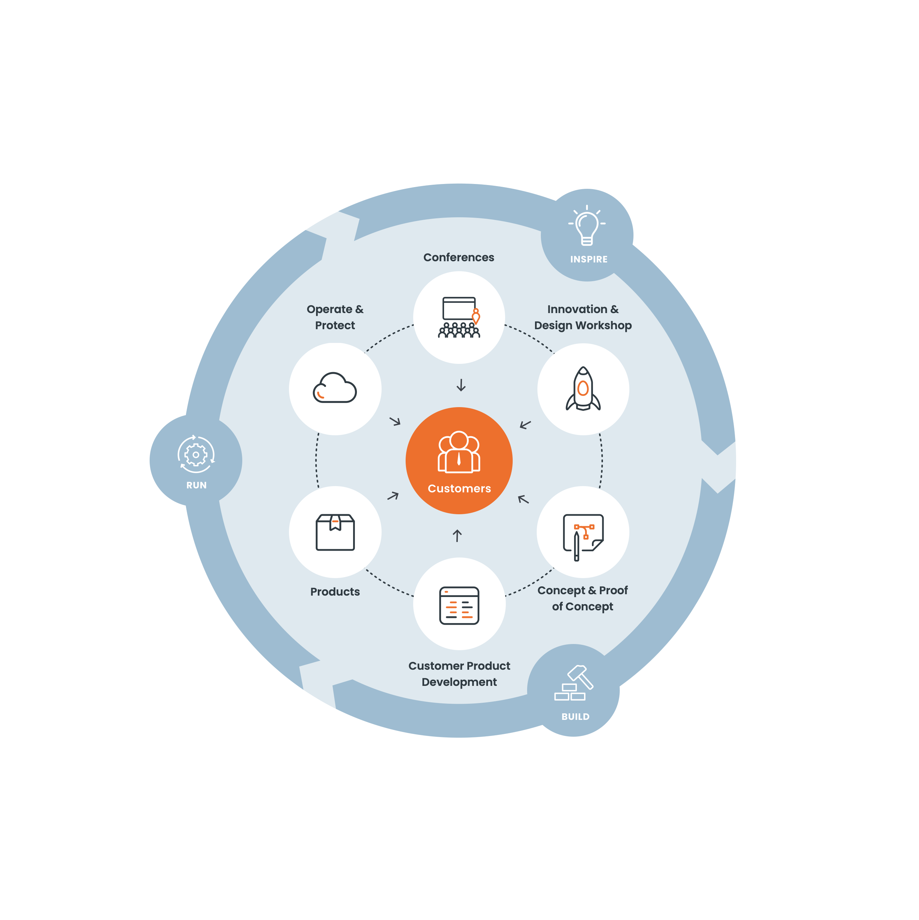
We believe that curiosity creates transformation
OUR APPROACH

Slide 8
What specific AI use cases are you prioritizing, and how are you preparing to leverage these technologies effectively?
QUESTION
Notes:
Hvad er de største udfordringer i oplever med jeres mobilbank ift til slutbrugerne?
Hvordan arbejder i med digitale produkter for at skabe en større loyalitet i forhold til jeres b2c kunder?
Når i arbejder med AI og mikroinnovation, hvad for nogle use cases har du så særligt fokus på og hvilke resultater forventer du at skabe?

Slide 9
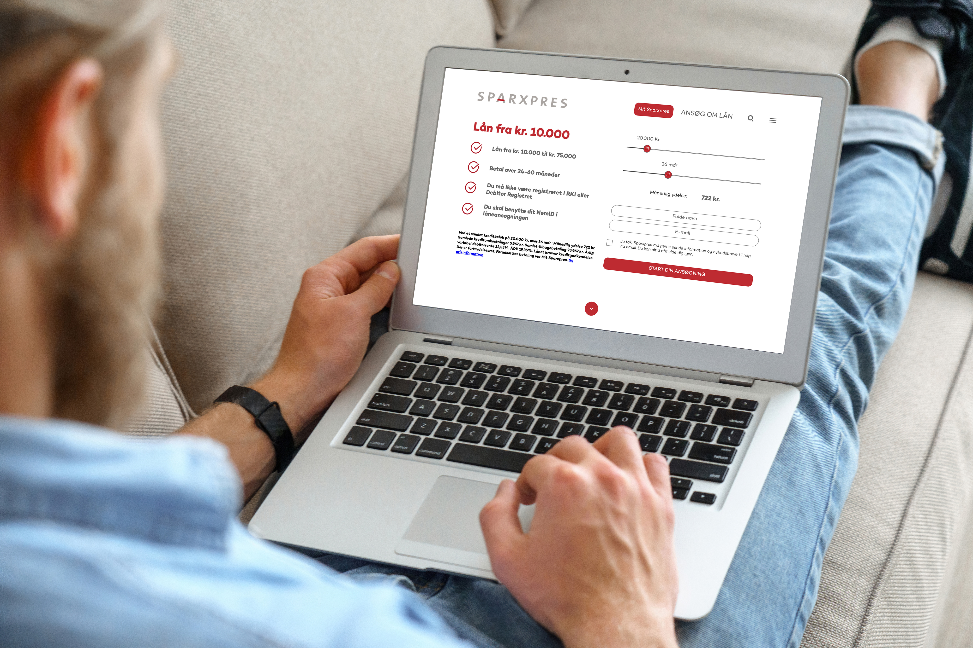

Future-proofing an entire bank card and consumer finance infrastructure
SPEEDBOATER | SUPER INTEGRATOR | TECH FRONT RUNNER
Sparxpres offers competitive digital financing and credit solutions

Slide 10
Operating on the Dankort infrastructure, Sparxpres aimed to enhance their payment ecosystem
CHALLENGE

Slide 11
Building a modern banking solution
FOCUS AREAS
1. | Transitioning from Dankort to Visa infrastructure to expand reach
2. | A new infrastructure for gift cards and a banking solution that encompasses loans
3. | Complete revision of payment infrastructure and customer-facing software to comply with EU rules

Slide 12
Enhanced payment infrastructure
VALUE
Versatile Platform
Quick Implementation
Empowering Retailers
Full Cycle
Delivery Journey
EU-compliant core. platform that offers credit and gift card solutions as well as prepaid payment cards
Core banking system implemented in less than six months helped by numerous integrations made by Trifork
Empowering merchants and retailers with client-facing web portal
Supporting Sparxpres from webend and backend development, seamless integrations and hosting on Trifork Cloud Stack

Slide 13
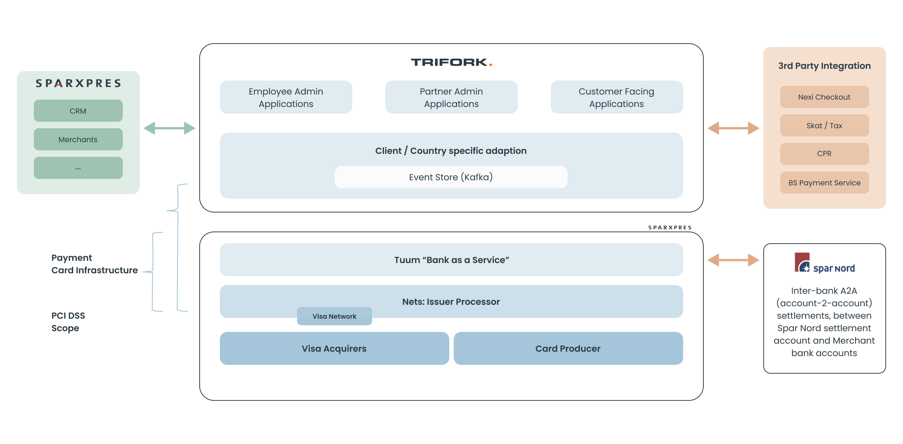
Custom card and financing platform with Tuum, Nets & Visa
ARCHITECTURE

Slide 14
EFFECT
Scalability
& increased earnings
Core platform enables new products to be easily introduced
The platform sets new standards for financing solutions in webshops, contributing to increased retailer turnover and earnings
Operating and capital expenses are notably reduced when compared to outdated legacy systems
6.5k
1.4m
Retail outlets
Transactions

Slide 15

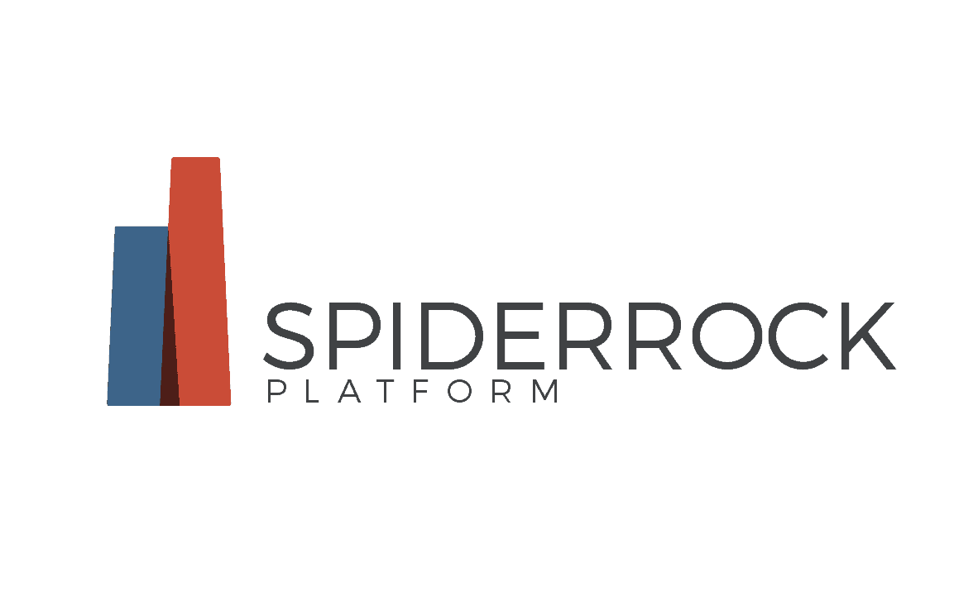
Revolutionizing options trading via an alternative trading system
SUPER INTEGRATOR
SpiderRock enables systematic traders to implement and scale multi-asset class strategies in a compliant framework

Slide 16
Develop SpiderRock’s ATS platform to automate block trade negotiations, matching and executions via an electronic auction.
CHALLENGE

Slide 17
Handling data challenges
FOCUS AREAS
1. | Handling high-speed performance requirements with low latency
2. | Processing thousands of real-time data points reliably
3. | Integrating live market data and visualizations for block auction workflows

Slide 18
High-performance, real-time trading platform
VALUE
Collaborative
Web Development
Optimizing Performance
Rich Visual
Data Insights
Collaborated with SpiderRock to develop a web-based app integrating their data platform.
Addressed bottlenecks, optimized latency and enabled real—time data processing.
Developed visualizations and assisted with hiring/training in-house staff in maintaining and evolving the product.

Slide 19
EFFECT
Enhanced trading efficiency and performance
The collaboration resulted in a robust, responsive platform that improved trading efficiency and positioned SpiderRock for future growth
Early customer praised the ATS for its seamless functionality and enhanced trading capabilities.

Slide 20


Speedboating a seamless and transparent onboarding journey
SPEEDBOATER | DESIGN THINKER
Jyske Bank is Denmark’s third-largest bank, offering comprehensive financial services.

Slide 21
Jyske Bank aimed to enhance and digitize their onboarding experience across various user journeys
CHALLENGE

Slide 22
Streamlining onboarding for efficiency and growth
FOCUS AREAS
1. | Simplifying a complex, manual onboarding system for new customers
2. | Balancing compliance with an engaging and smooth user experience
3. | Seamless integration with Jyske Bank’s IT frameworks while ensuring scalability for future customer journeys

Slide 23
Agile solutions for seamless onboarding
VALUE
Service
Design
Design
Sprint
Flexible
Platform
Seamless
Integration
Trifork implemented a service design strategy using agile methods and rapid prototyping
A 14-days sprint identified pain points and co-created solutions with stakeholders
Developed a flexible platform that simplified document submission to help manage budget and loans
Leveraged existing IT frameworks for smooth functionality in their mobile and online systems

Slide 24
EFFECT
Accelerated onboarding and future-ready scalability
New onboarding solution delivered in 6 months
Simplified and streamlined the user journey for both private and part-customers
Ongoing support ensures adaptability and scalability for Jyske Banks client base

Slide 25


Automating work processes through data orchestration for leading pension company
SUPER INTEGRATOR | STRATEGIC PARTNER
Nærpension – a fully owned subsidiary of the 4th largest pension company in Denmark, AP Pension

Slide 26
Nærpension faced manual inefficiencies in pension management workflows
CHALLENGE

Slide 27
FOCUS AREAS
1. | Digitizing and automating manual workflows
2. | Enhancing data quality due to fragmented processes
3. | Need for a comprehensive solution to integrate multiple systems and stakeholders
Automation &
Integration across
lifecycle policies

Slide 28
Orchestrating efficiency
VALUE
Lifecycle Management
A Unified
Solution
Unique Selling Point
360-degree solution for managing insurance and savings products through the entire lifecycle of the policies
The solution acts an orchestrator of interactions between various internal and external systems
The advisors can remain in their familiar systems

Slide 29
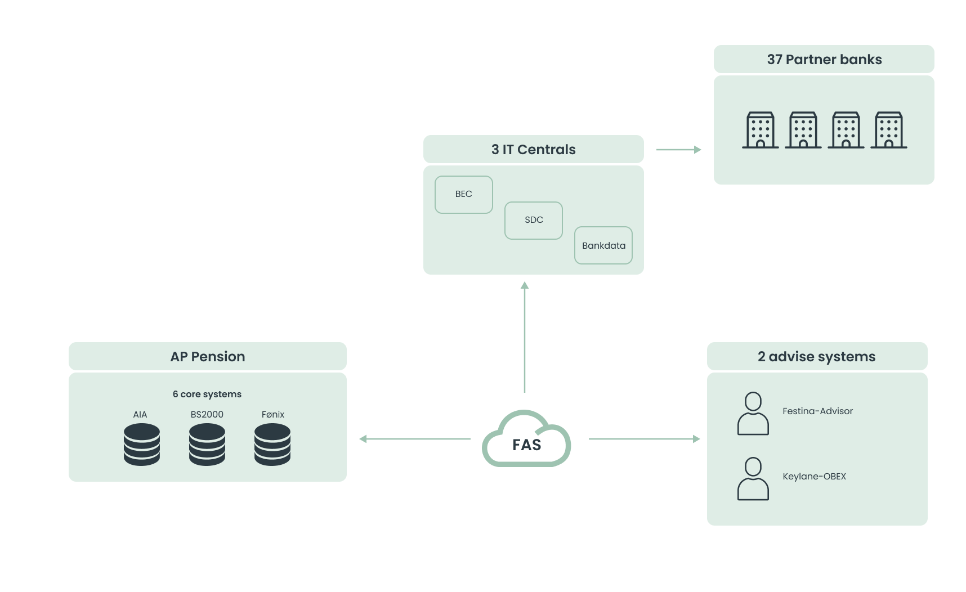
ARCHITECTURE
Automating advisory processes and integrating back-end systems to streamline policy creation

Slide 30
EFFECT
Optimized efficiency
& reduced cost
Increased revenue & reduced cost
Improved data quality & streamlined operations
Enhanced brand value and strengthened competitive position in the market

Slide 31


&bookme: efficient and compliant appointment booking
DESIGN THINKER | SPEEDBOATER | CO-OWNER & TECH PARTNER
&money offers a range of industry-tailored digital solutions that optimize workflows and processes.

Slide 32
Streamline and automate the process of scheduling meetings between bank advisors and clients
CHALLENGE

Slide 33
Appointment scheduling made easy
FOCUS AREAS
1. | Improving appointment scheduling for clients
2. | Reducing administrative tasks for. bank advisors
3. | Integration and synchronization between existing systems

Slide 34
The improved customer journey
VALUE
Self-Service Solutions
Improved Customer Journey
Eliminating Manual Workload
Quick Implementation
Book meeting via self-service solution for clients in less than two minutes
Automatically creates meetings in Outlook / Microsoft 365 & bank’s CRM system, eliminating the need for manual updates
Solution finds the best time in terms of meetings to topic, advisor competencies and customer categories
Time to market in 6 months

Slide 35
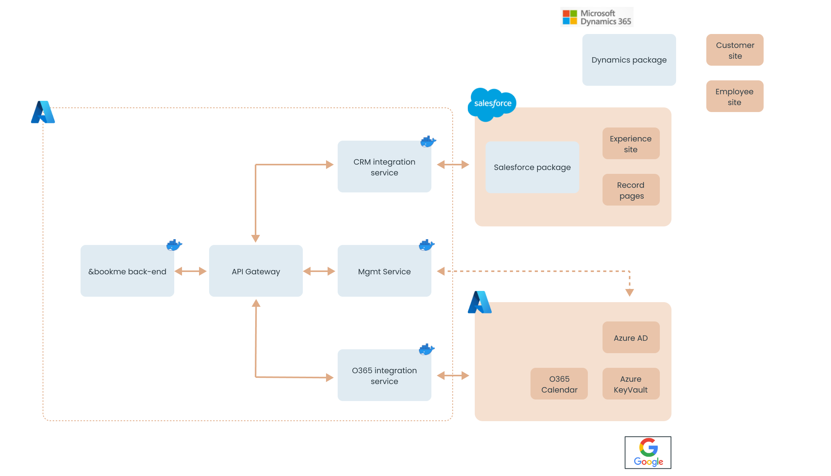
Seamless Scheduling: Developing &bookme solution with Nykredit, SparNord & Arbejdernes Landsbank
ARCHITECTURE
&bookme customer
&money multi-tenant SAAS backend
&bookme customer

Slide 36
EFFECT
Reduced administrative cost & scalability
Automation and efficient scheduling reduced the operational costs associated with manual meeting arrangements
The solution’s design enabled easy onboarding of new banks, supporting growth & adaptability

Slide 37

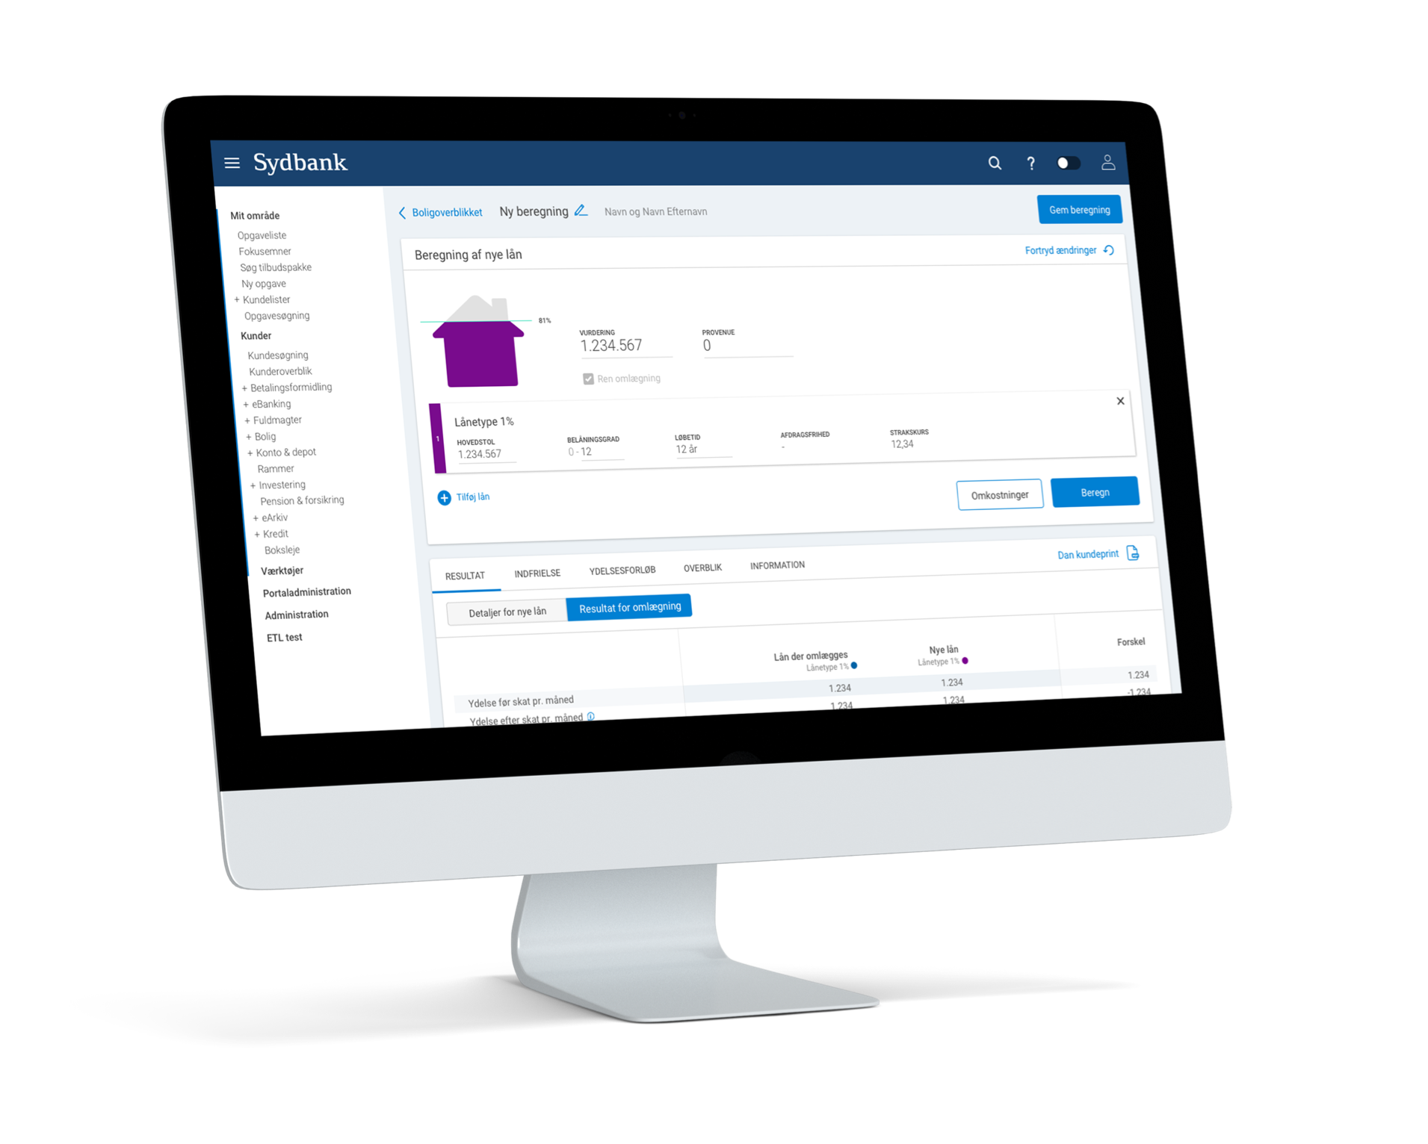


Fast tracking mortgage loans
DESIGN THINKER | SPEEDBOATER | SUPER INTEGRATOR
Bankdata provides IT solutions to Danish banks to streamline operations. Sydbank is one of the largest banks in Denmark.
Notes:
NÆVN BEGG

Slide 38
Bankdata and Sydbank faced challenges in their mortgage loan process, characterized by manual data entry tasks and system integration issues.
CHALLENGE

Slide 39
Optimizing mortgage processes
FOCUS AREAS
1. | Eliminate unnecessary steps and streamline the mortgage loan process
2. | Reduce the excessive time advisors. spend on manual data entry across. multiple systems
3. | Develop a user-friendly interface that. allows the advisors to switch to a. customer-facing view

Slide 40
Transforming legacy system into a modern solution
VALUE
Design Thinking Workshop
Scalable Platform
Guided Flow
The solution is a result of a Trifork Design Thinking workshop
Flexible and scalable platform with seamless integration to 3rd party systems
Developed an intuitive and guided flow to support advisors in producing relevant documents efficiently

Slide 41
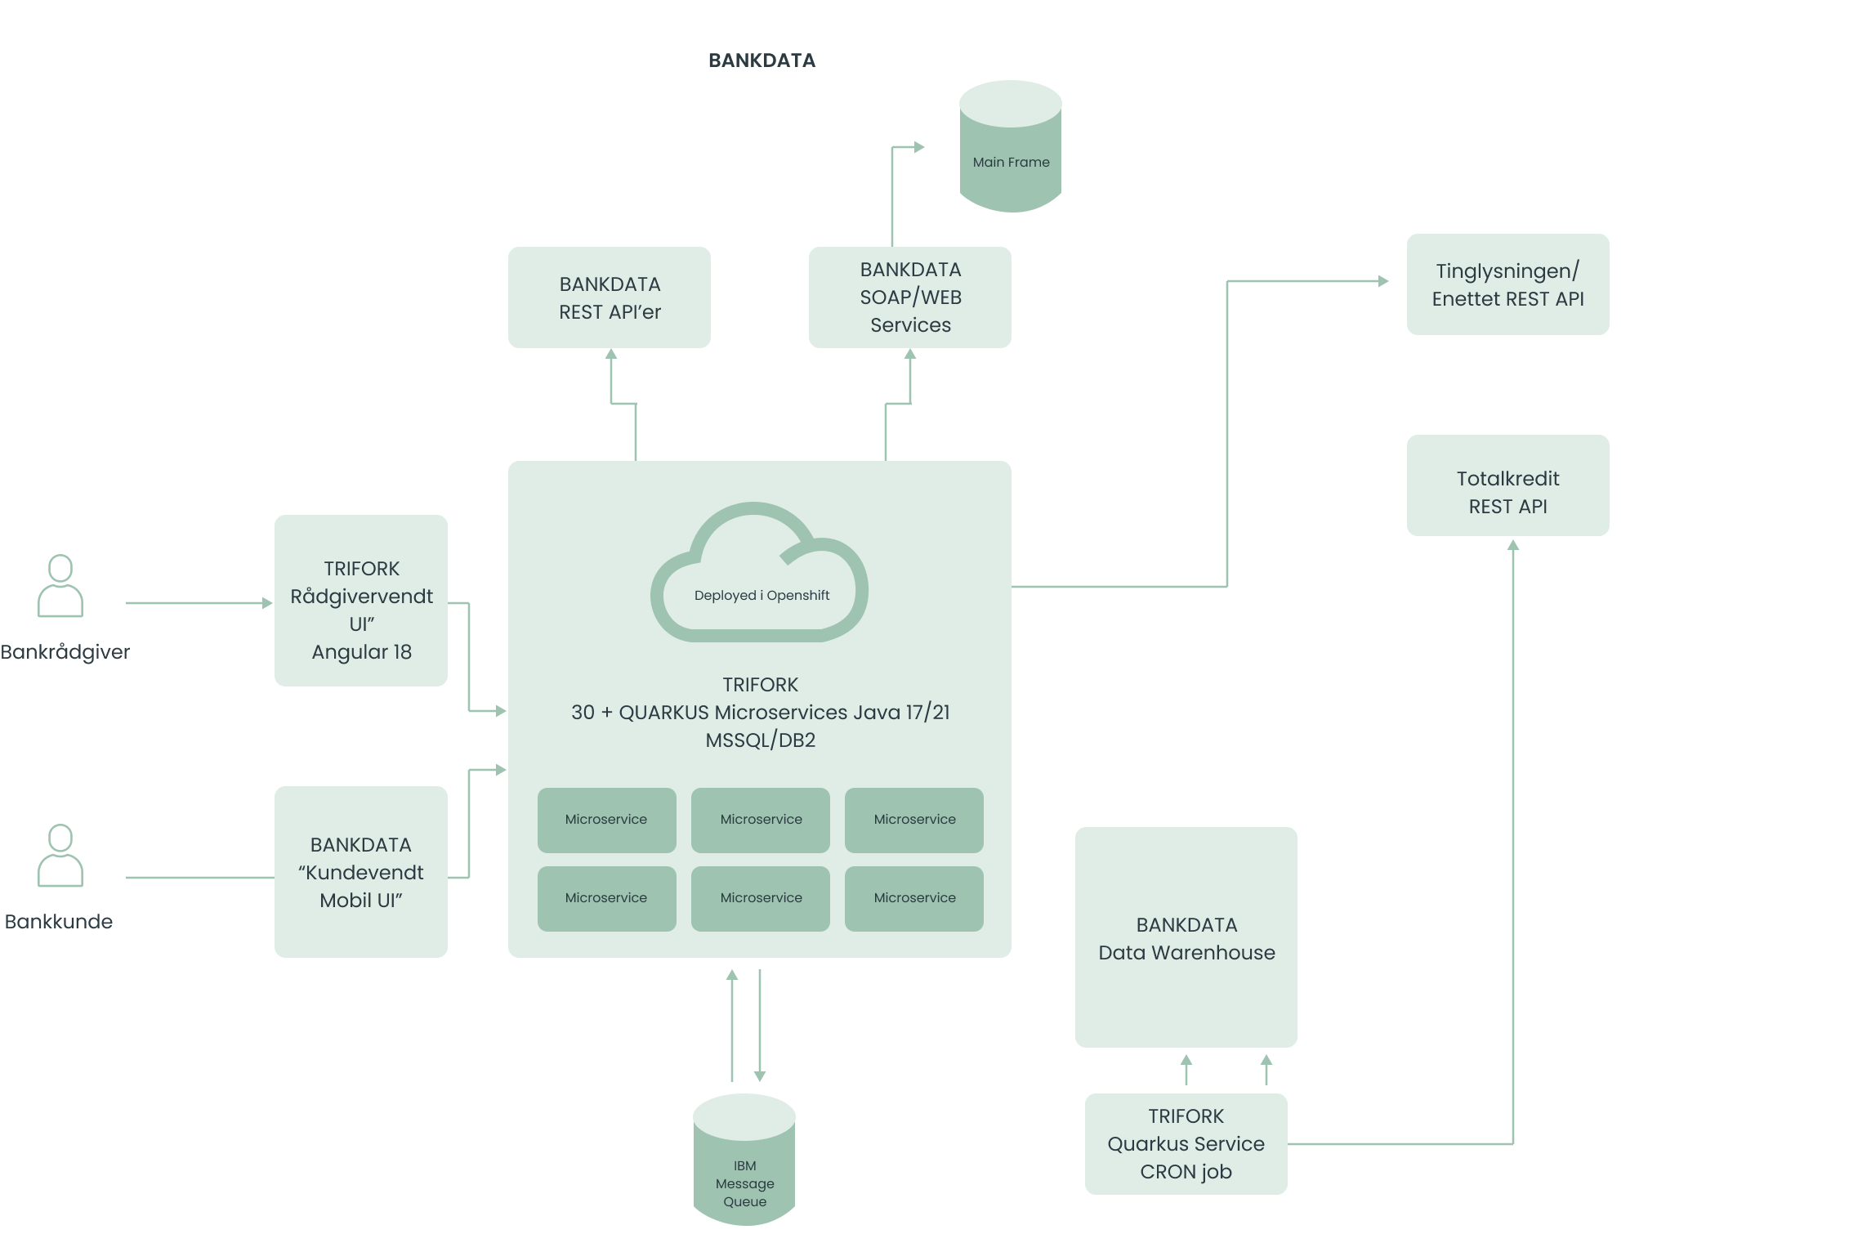
Optimizing the mortgage loan process to a more cost-efficient and transparent solution that is easier to maintain, support & extend
ARCHITECTURE

Slide 42
EFFECT
Enhanced workflow & customer satisfaction
Increased performance and productivity as tasks now are performed in the correct order
Enhanced customer satisfaction through a more transparent mortgage loan journey
Primary mortgage tool for 9 banks
2.4K+
12K+
2.5
BANK ADVISORS USING THE SOLUTION
CALCULATIONS EVERY WEEK
HOURS REDUCED
PER CASE

Slide 43

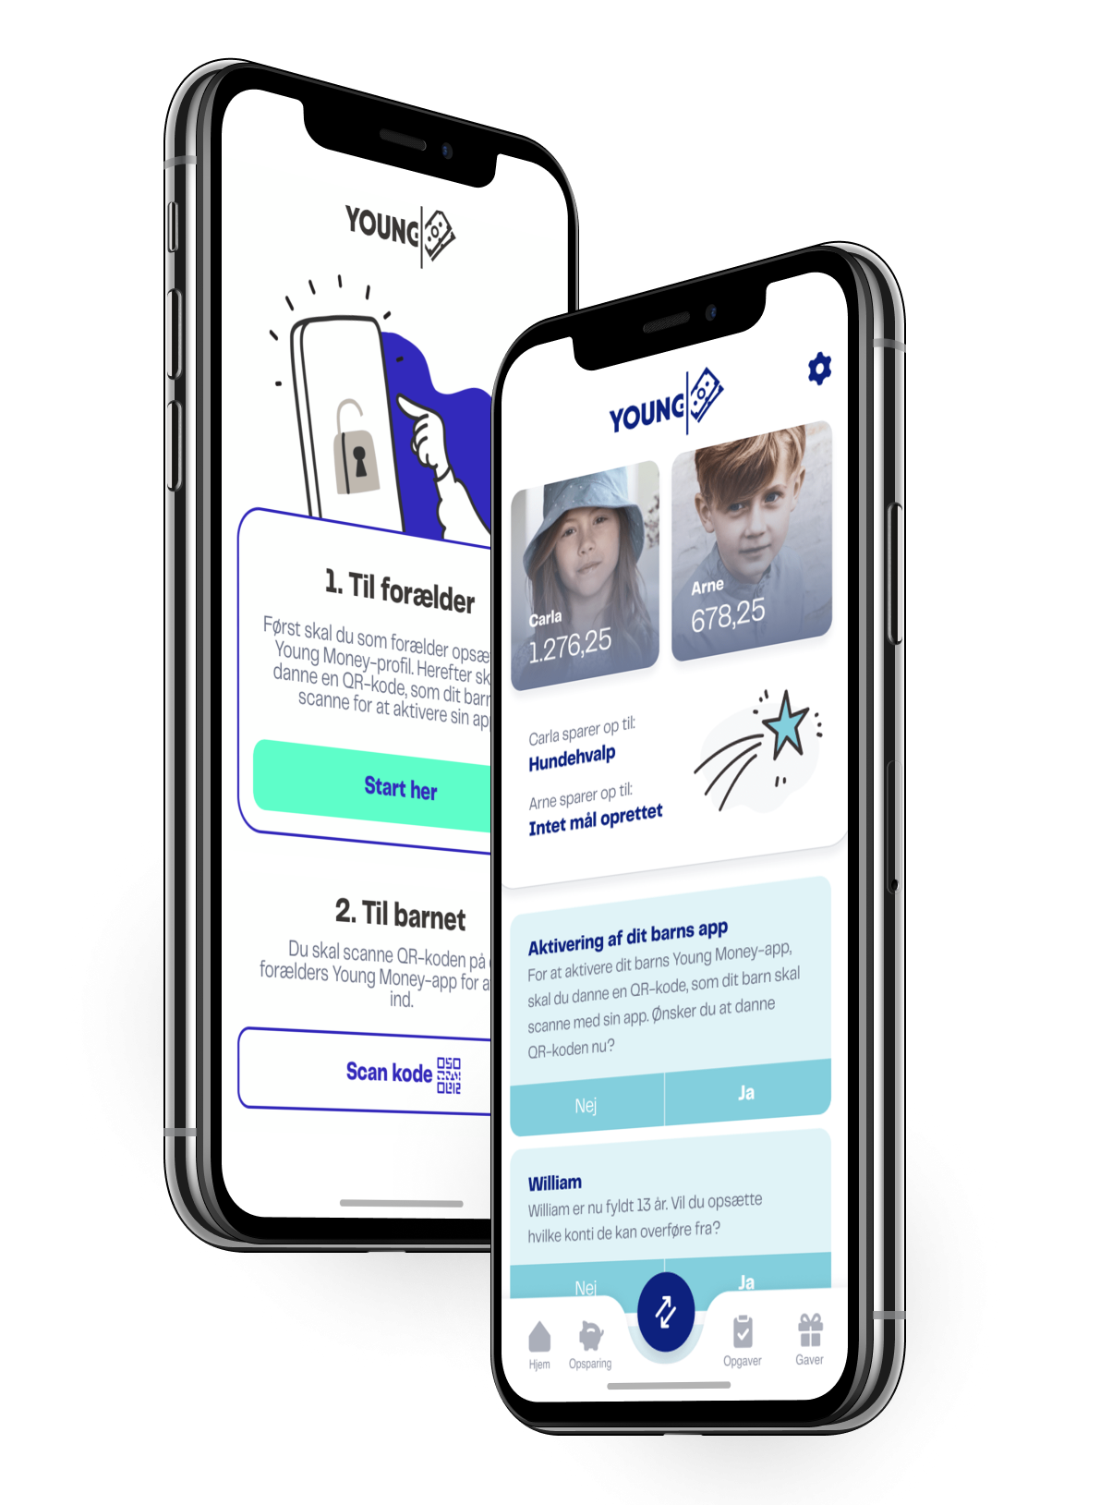
User-friendly money & savings universe for children
DESIGN THINKER | SPEEDBOATER | SUPER INTEGRATOR
&money offers a range of industry-tailored digital solutions that optimize workflows and processes.

Slide 44
Providing children earlier access to mobile banking, adapted to their needs
CHALLENGE

Slide 45
Overcoming legal, technical & security barriers
FOCUS AREAS
1. | Earlier access to digital banking. solutions for children below 15 years old
2. | Legal, technical, and security barriers. in developing a secure solution
3. | Ensuring seamless integration with. other banks’ systems

Slide 46
Secure & integrated digital banking for children
VALUE
Dual-interface
Data Security
Cloud-Based Solution
Offers dual-interface for children under 18 and their parents, giving children access through parents MitID
High security towards privacy data (Microsoft Azure Key Vault / Hardware Security Module)
Redesigning the architecture to a cloud-native application on Microsoft Azure Cloud for easier implementation by future banks

Slide 47
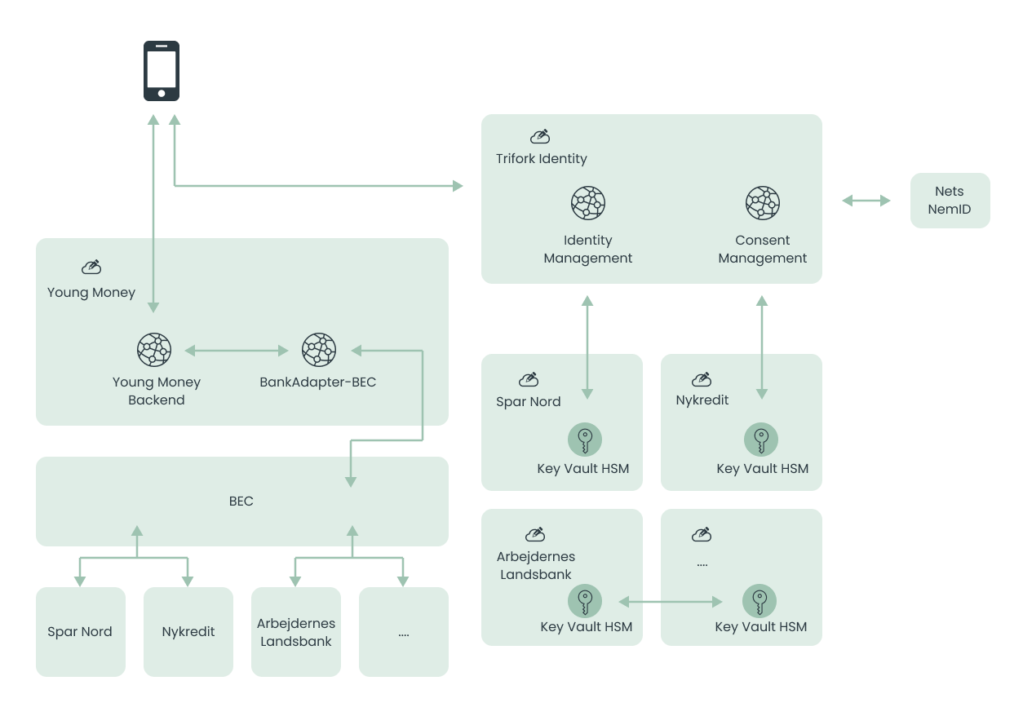
User-friendly money & savings universe for children with Spar Nord, Nykredit
& Arbejdernes Landsbank
ARCHITECTURE

Slide 48
EFFECT
Innovation
& expansion
The solution gives banks the ability to offer a product that didn’t exist before
Easily implementation for future banks and partners
45K+
12K+
8
ACTIVE USERS
TRANSFERS PER MONTH
BANKS

Slide 49
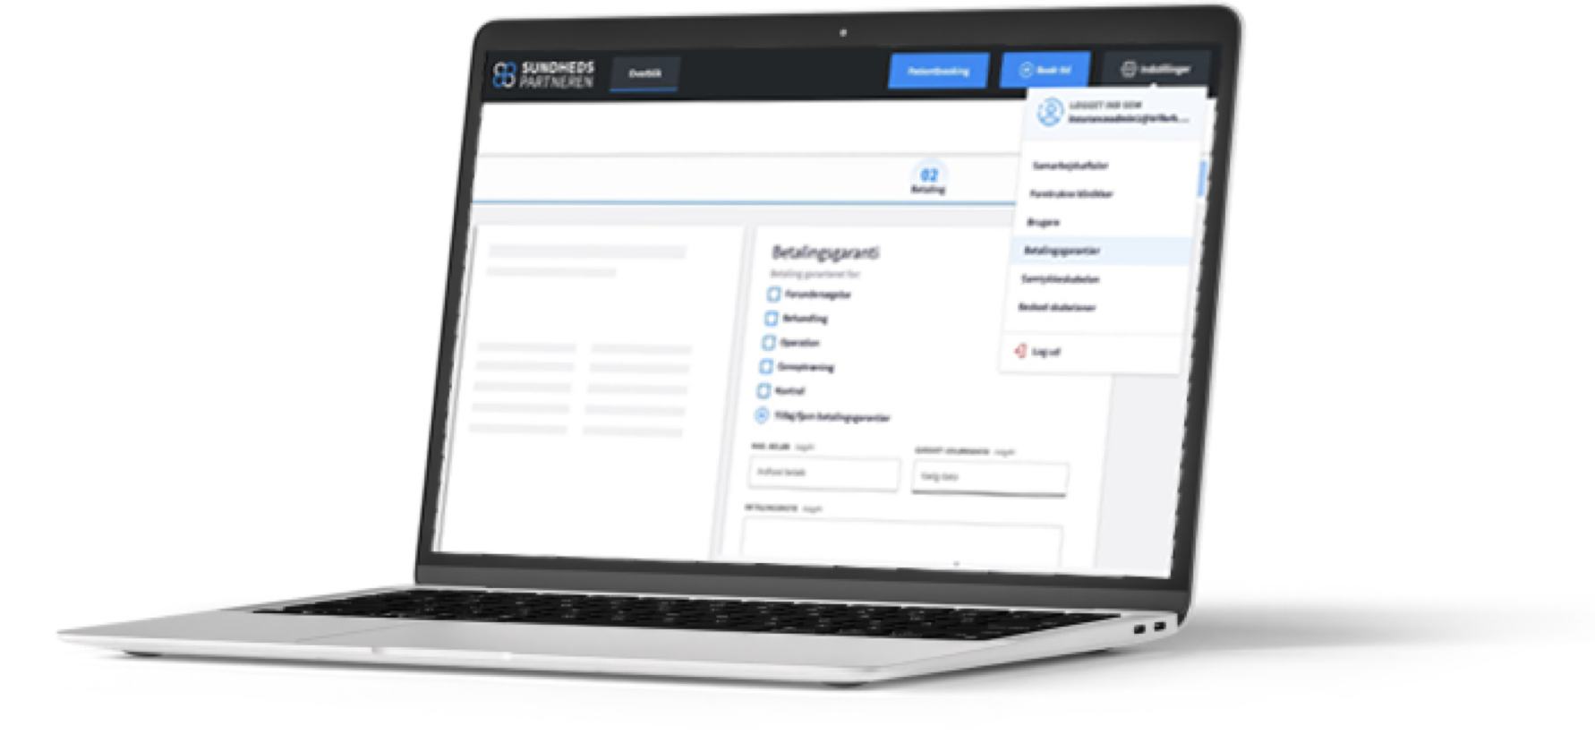

Perfecting customer service in health insurance through a self-service platform
DESIGN THINKER | SUPER INTEGRATOR | CO-OWNER & TECH PARTNER
Sundhedspartneren is a communication platform between healthcare providers, insurance companies, and patients.

Slide 50
Trifork partnered with Sundhed Danmark to tackle fragmented IT systems in Denmark’s private healthcare sector
CHALLENGE

Slide 51
Streamlining the patient journey while reducing cost
FOCUS AREAS
1. | Reduce time-consuming processes with a high risk of manual errors
2. | Enhance communication between healthcare providers and insurance companies
3. | Need for GDPR compliance and security due to handling sensitive personal data

Slide 52
Enhancing service offerings and focus on growth
VALUE
Platform Development
Efficient Data Exchange
Process Standardization
Self-service Booking
Developed ”Sundhedspartneren”, a booking and communications platform
Streamlined communication and data exchange between healthcare providers and insurance companies
Scalable solution and standardizes several processes
Patient empowerment with self-service booking

Slide 53
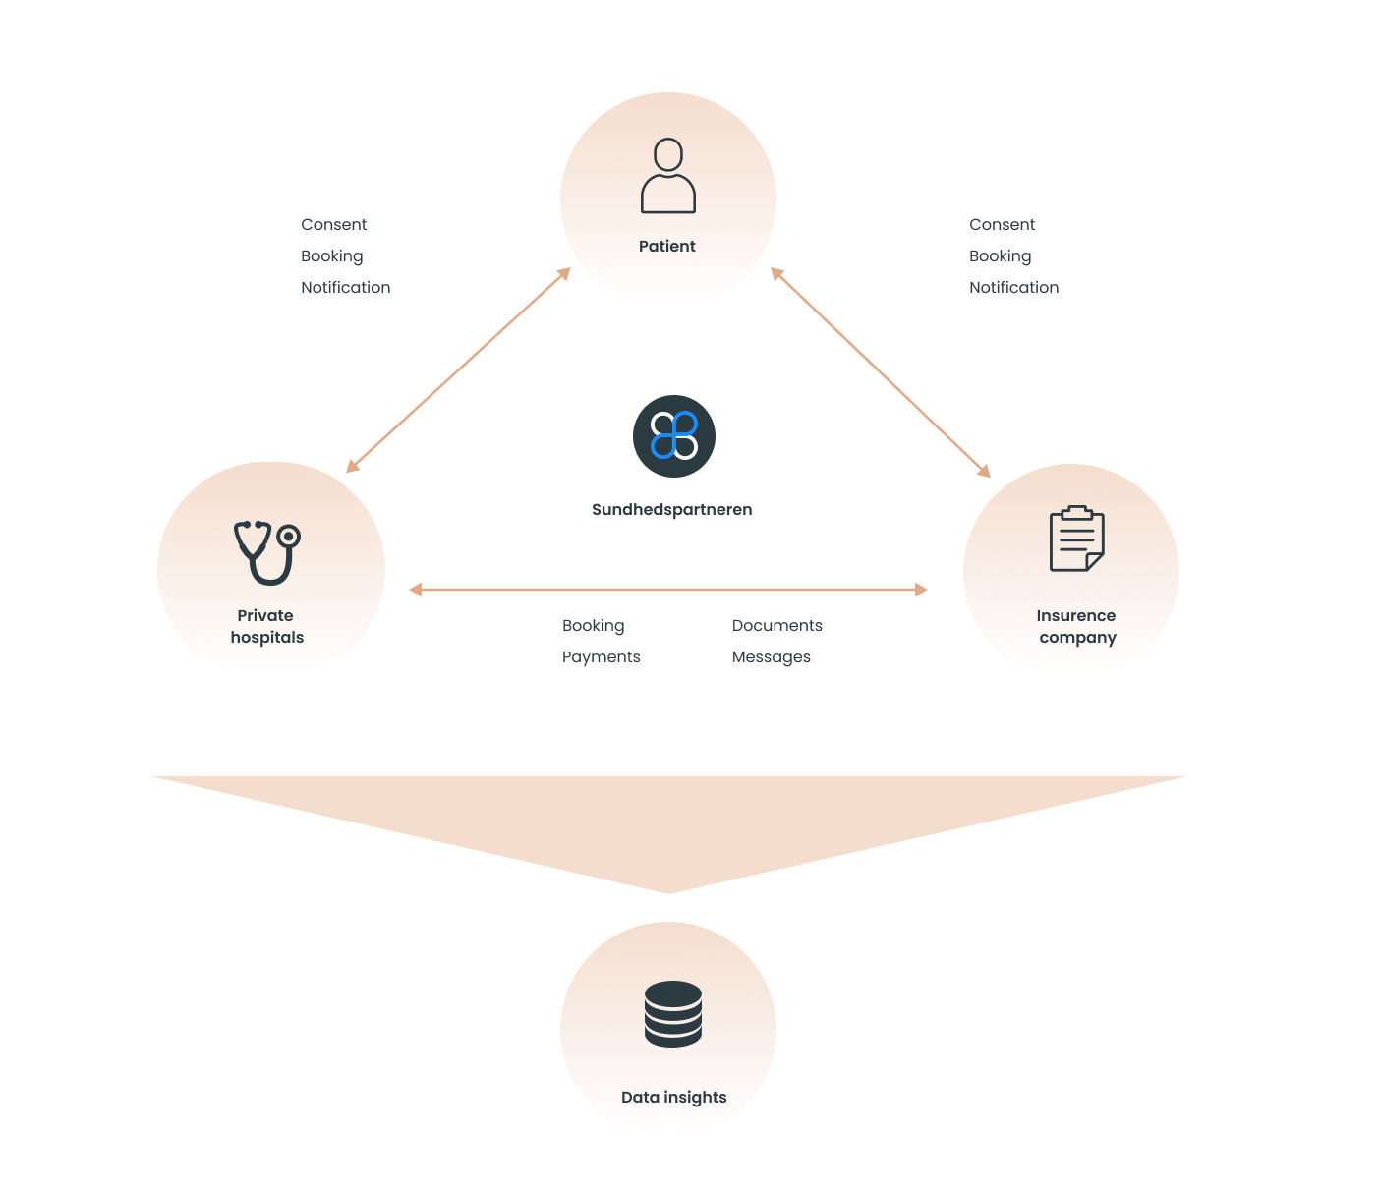
Self-service platform for easy, secure and efficient communication and booking with Sundhed Danmark
ARCHITECTURE

Slide 54
EFFECT
Enhanced efficiency & patient care through unified communication
Cost reductions and decreased administrative workload for insurance companies and healthcare providers
Shorter waiting times for patients and personalized treatment schedules
Platform expansions to international markets, aiming to set new standard in Northern Europe

Slide 55


Co-creating a secure and cost-effective B2B sender platform
DESIGN THINKER | SUPER INTEGRATOR
Kivra is a Swedish digital postal service, that gathers all your important documents in one secure and easy to use app.

Slide 56
Kivra sought a faster and easier way for their B2B clients to send important content and communications to end-users.
CHALLENGE

Slide 57
Streamlined, secure & stable development
FOCUS AREAS
1. | Improve a fragmented and time-consuming development processes
2. | Seamless integration of new features while maintaining platform stability
3. | Ensure the platform is highly secure and resilient to meet regulatory standards

Slide 58
VALUE
Driving innovation and efficiency through advanced practices
Design & Development
Remote Development Team
GraphQL for Efficiency
Implemented advanced design & development practices, including Design Thinking & team programming
Assembled a remote team of backend, frontend and UX specialists to rapidly build and test new services
Utilized GraphQL open-source technologies to reduce operating costs and increase security

Slide 59
EFFECT
Improved efficiency
and security
Significantly reduced operating costs and increased platform security
Faster development environment for new services
70% of the adult population in Sweden use Kivra

