Slide 1
Harvest the advantages of AI with Trifork
WORK WITH AN EXPERIENCED AI INTEGRATOR

Slide 2
The Situation Within AI Right Now
Generative AI has changed the perception of what is possible with AI/ML within text, image, video and sound
New products/services are being introduced every day. How to stand out in a very crowded space?
We started working with ML/AI many years ago, meaning a high level of competence and hands-on experience
Trifork can help from POC to production
Notes:
Vi plejer ikke at have AI intro slides med fordi folk ved det godt. Hvis der skal være 1-2 slides kan det være med udgangspunkt I de 2 her
Det er ikke vigtigt og måske står decket bedre hvis de ikke er med og kun har focus på cases

Slide 3
AI / Machine Learning: Common Concerns
Security, GDPR, legal/compliance
Public vs. private models, open-source vs. closed-source models
Training/Inspiration - What is achievable and how to do it?
Notes:
Vi plejer ikke at have AI intro slides med fordi folk ved det godt. Hvis der skal være 1-2 slides kan det være med udgangspunkt I de 2 her
Det er ikke vigtigt og måske står decket bedre hvis de ikke er med og kun har focus på cases

Slide 4
AI is Not Black Magic
Notes:
Vi plejer ikke at have AI intro slides med fordi folk ved det godt. Hvis der skal være 1-2 slides kan det være med udgangspunkt I de 2 her
Det er ikke vigtigt og måske står decket bedre hvis de ikke er med og kun har focus på cases

Slide 5
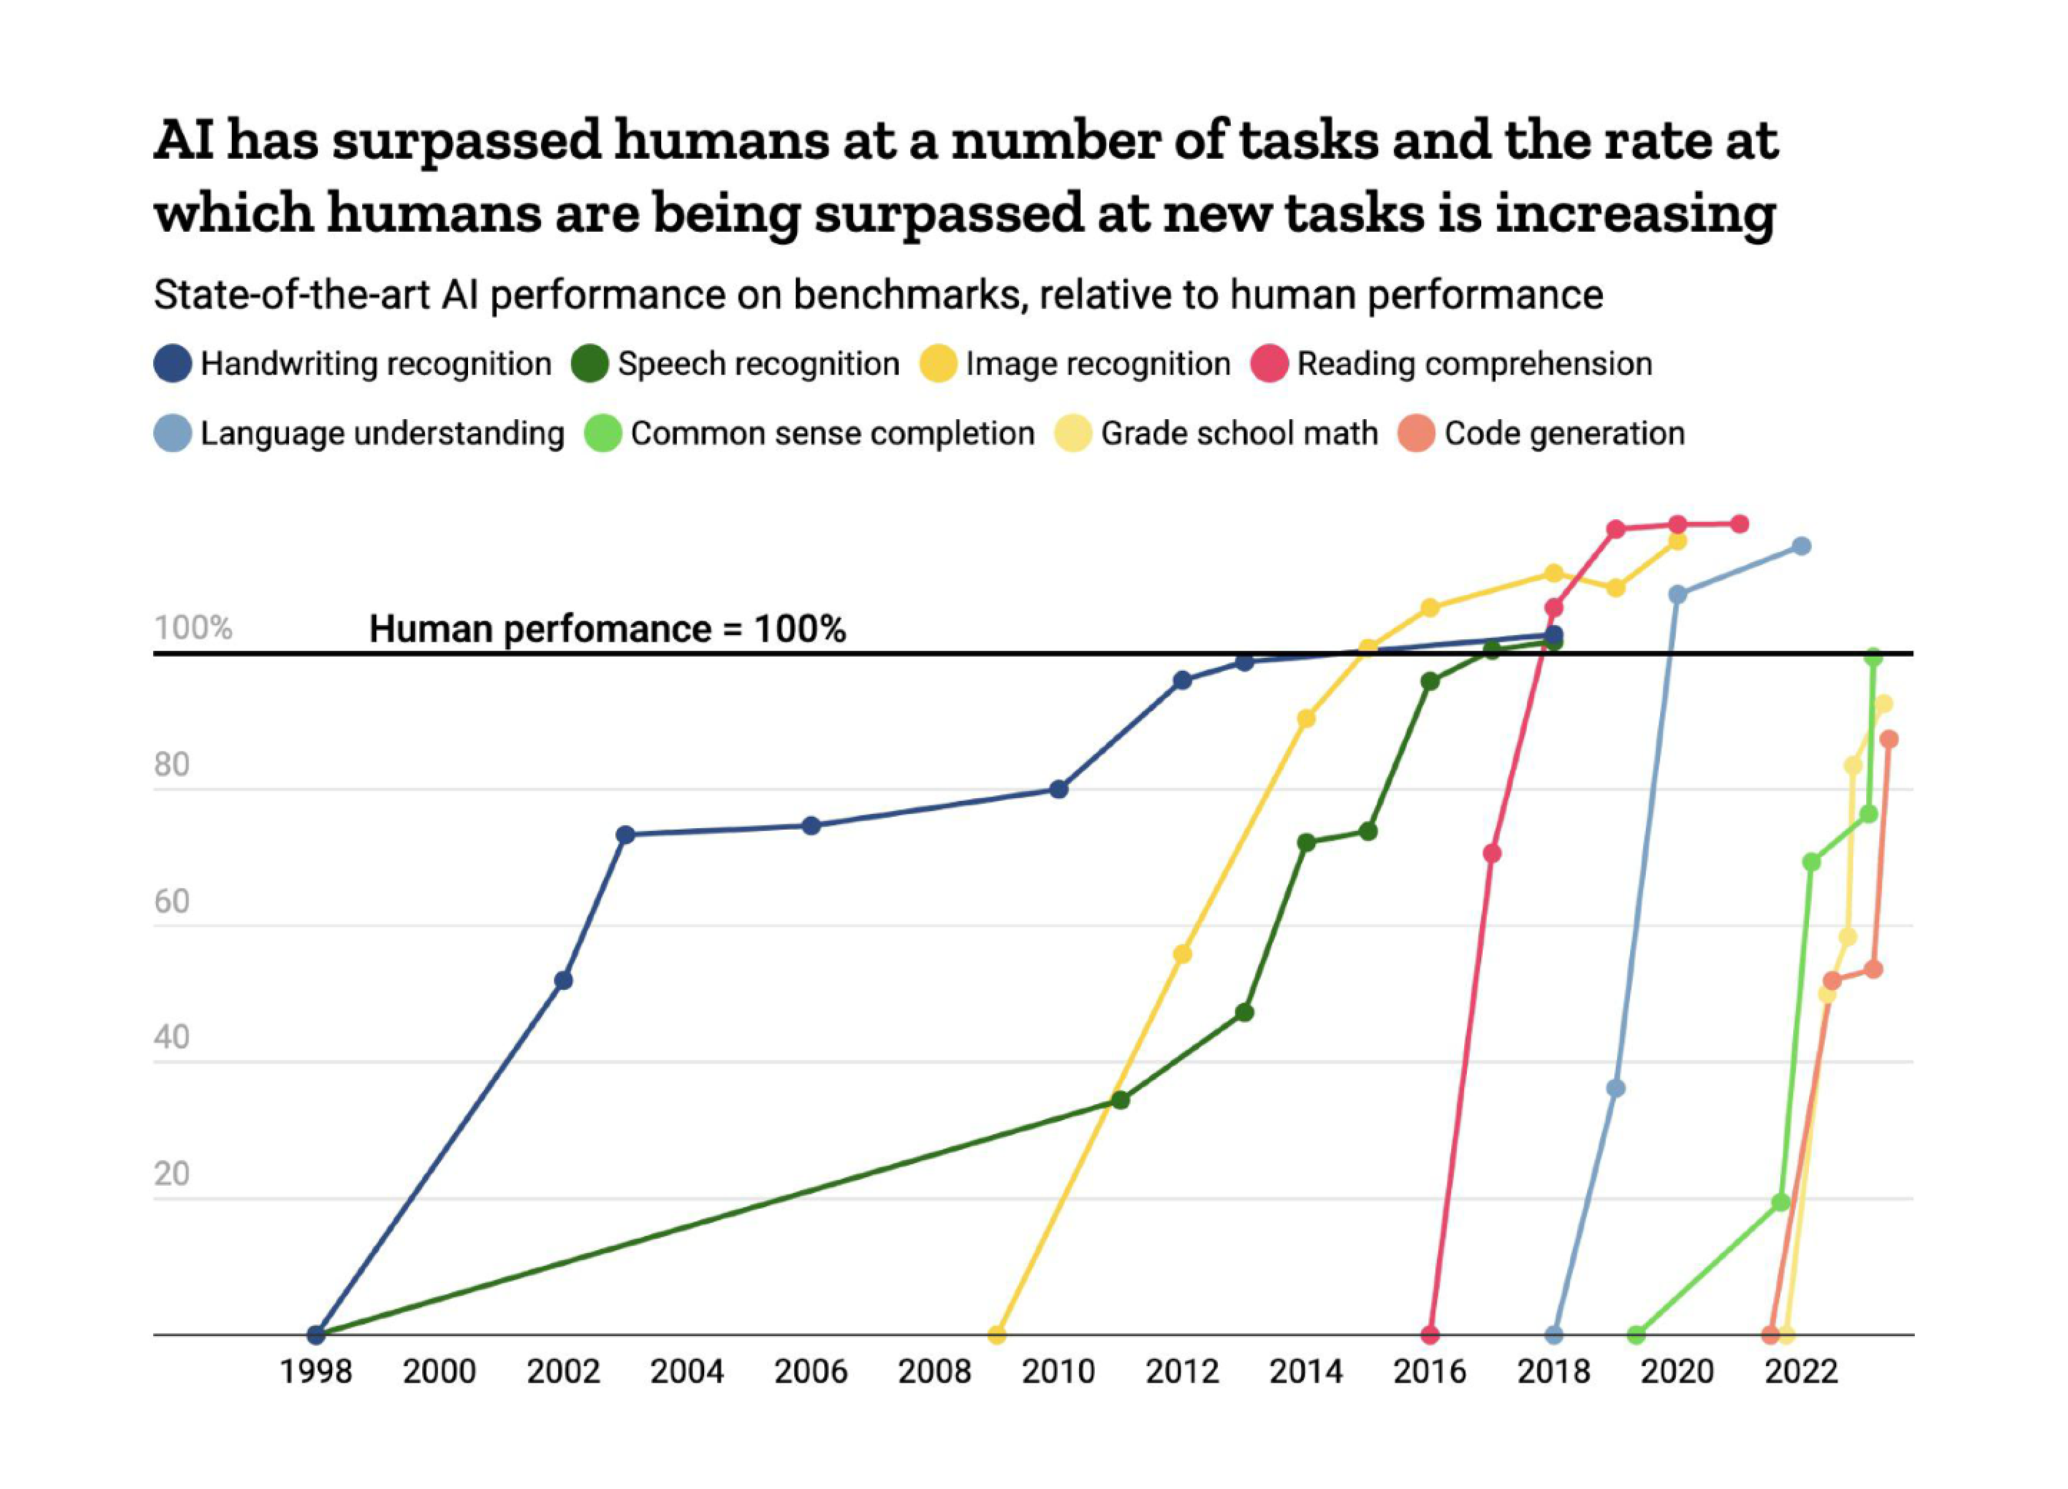
Chart: Will Henshall for TIME • Source: ContextualAI
Notes:
For each benchmark, the maximally performing baseline reported in the benchmark paper is taken as the “starting point”, which is set at 0%. Human performance number is set at 100%. Handwriting recognition = MNIST, Language understanding = GLUE, Image recognition = ImageNet, Reading comprehension = SQuAD 1.1, Reading comprehension = SQuAD 2.0, Speech recognition = Switchboard, Grade school math = GSK8k, Common sense completion = HellaSwag, Code generation = HumanEval.

Slide 6
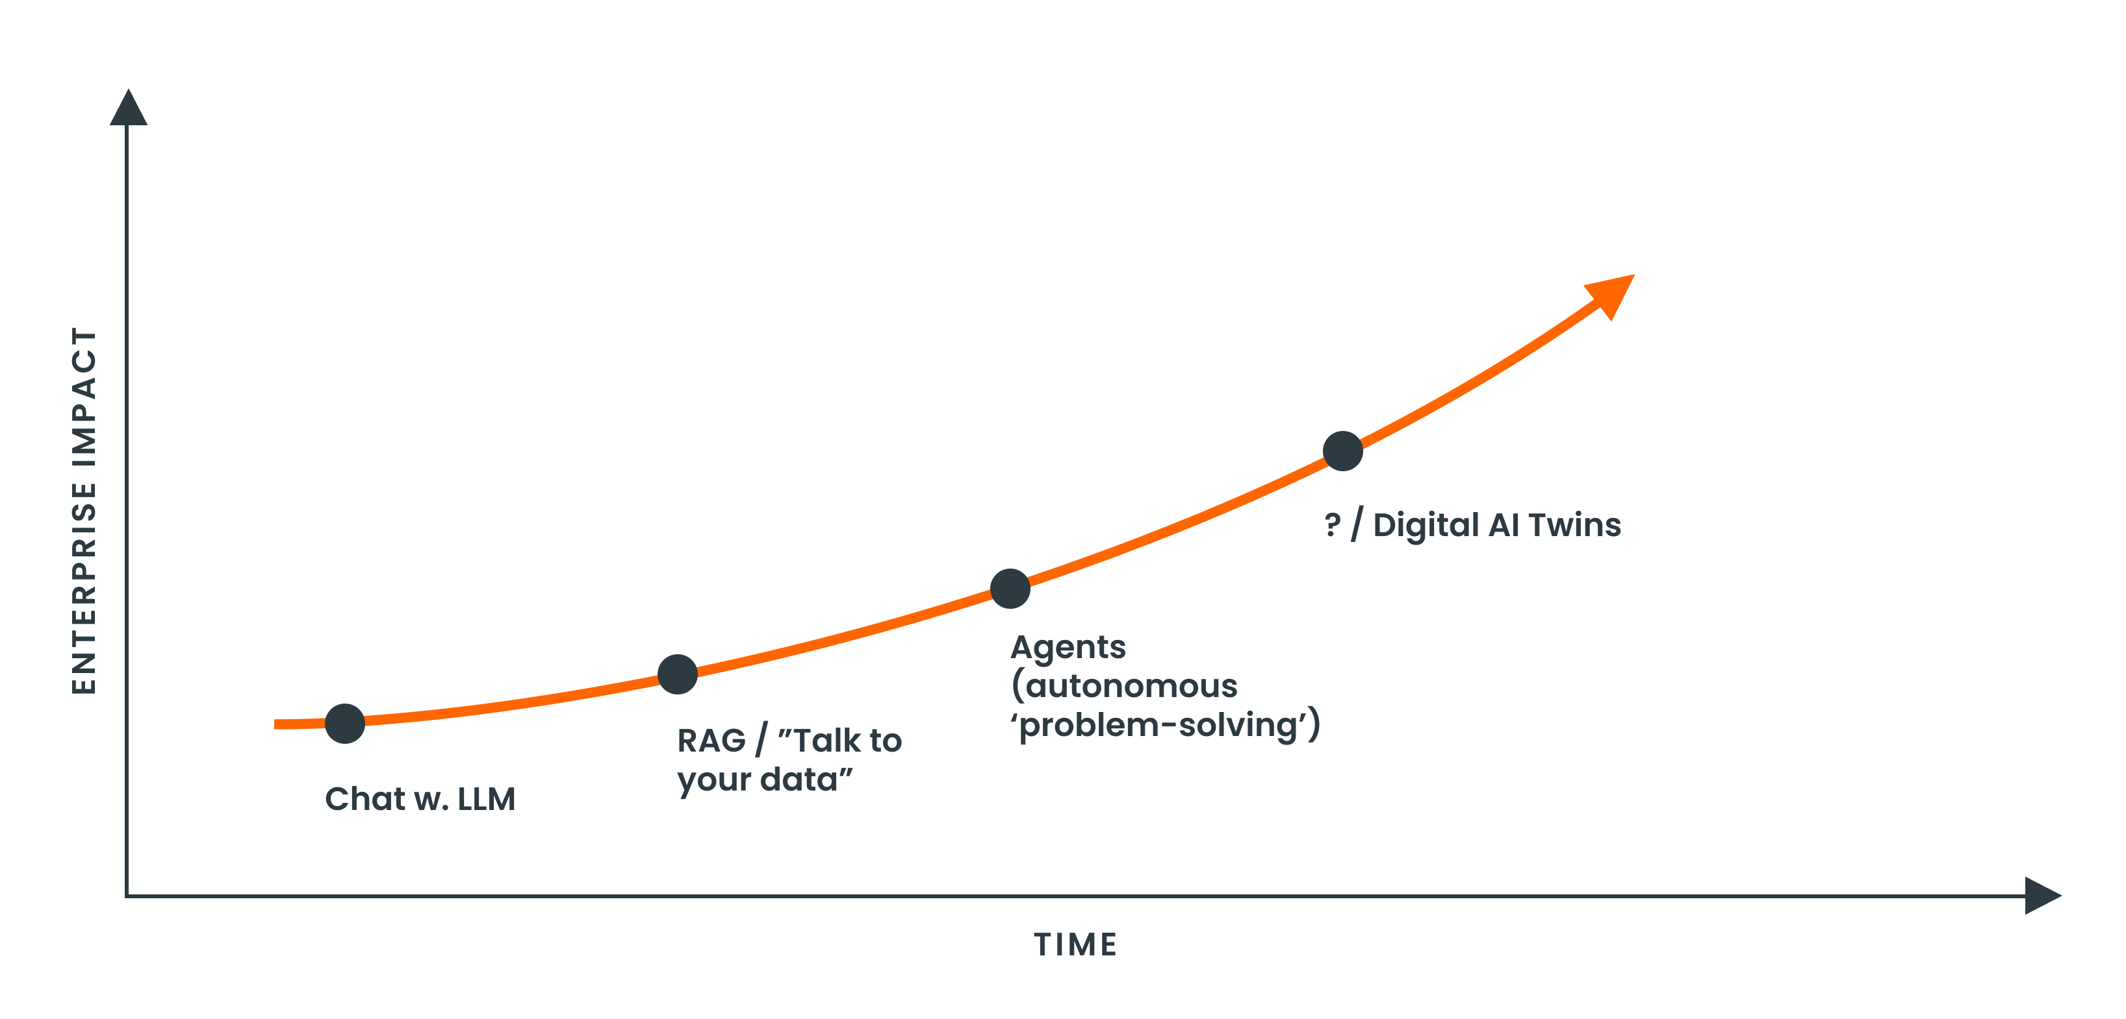
Artificial Intelligence Evolution

Slide 7
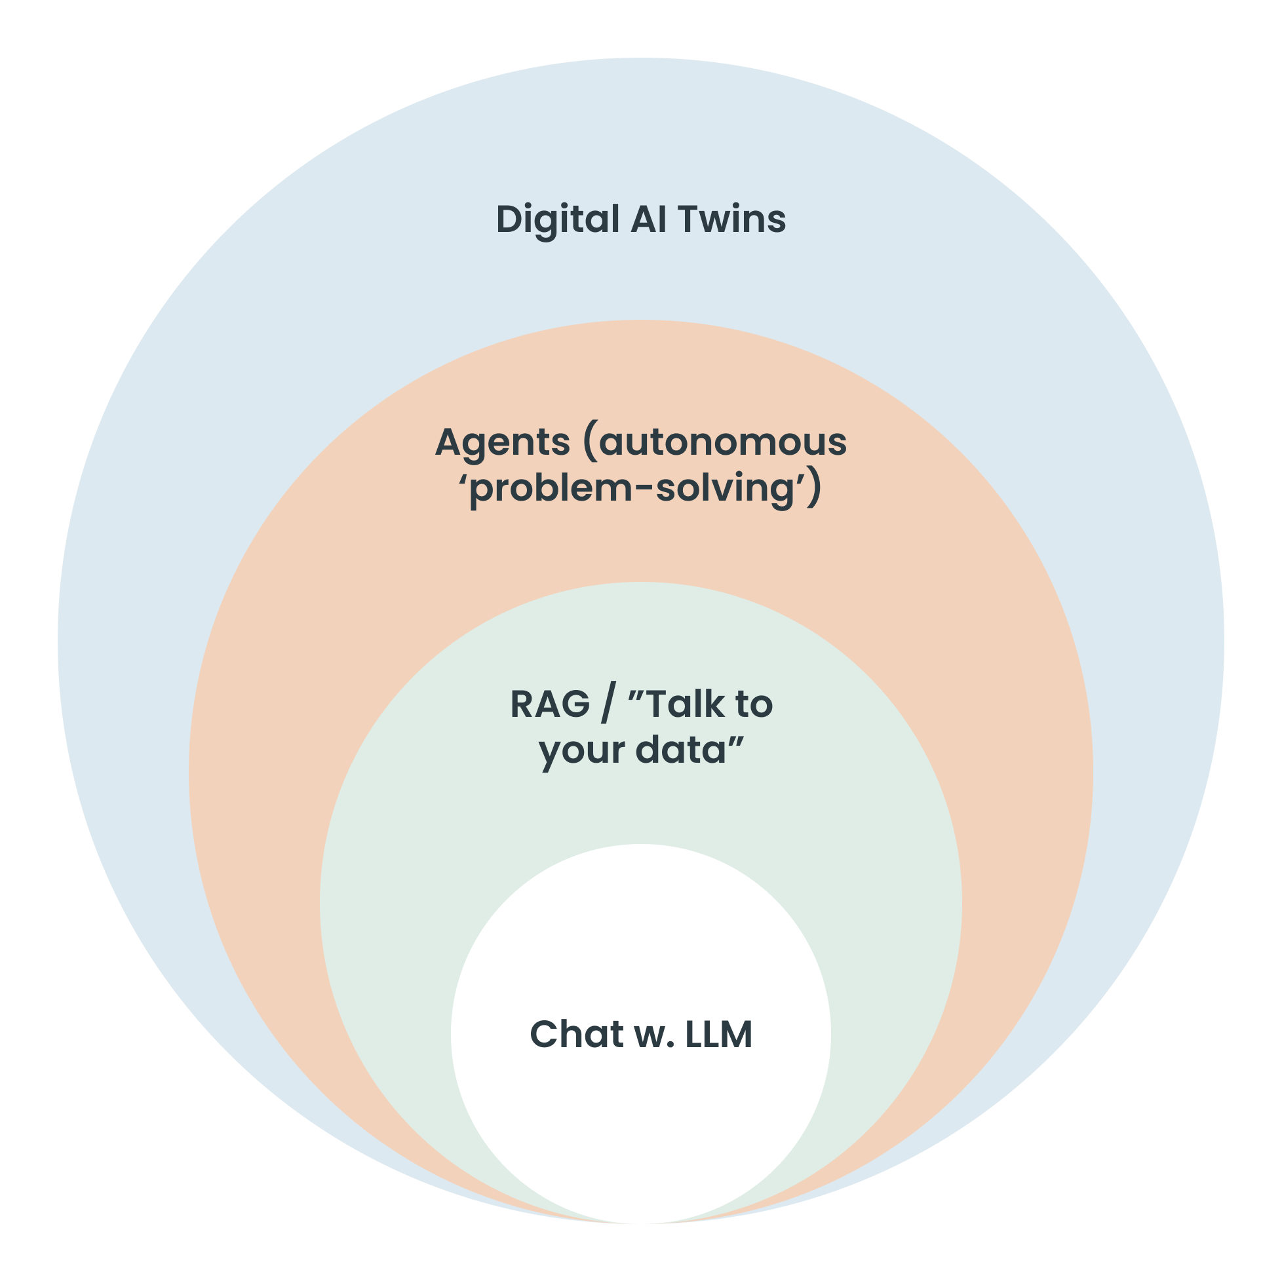
Artificial Intelligence Evolution

Slide 8
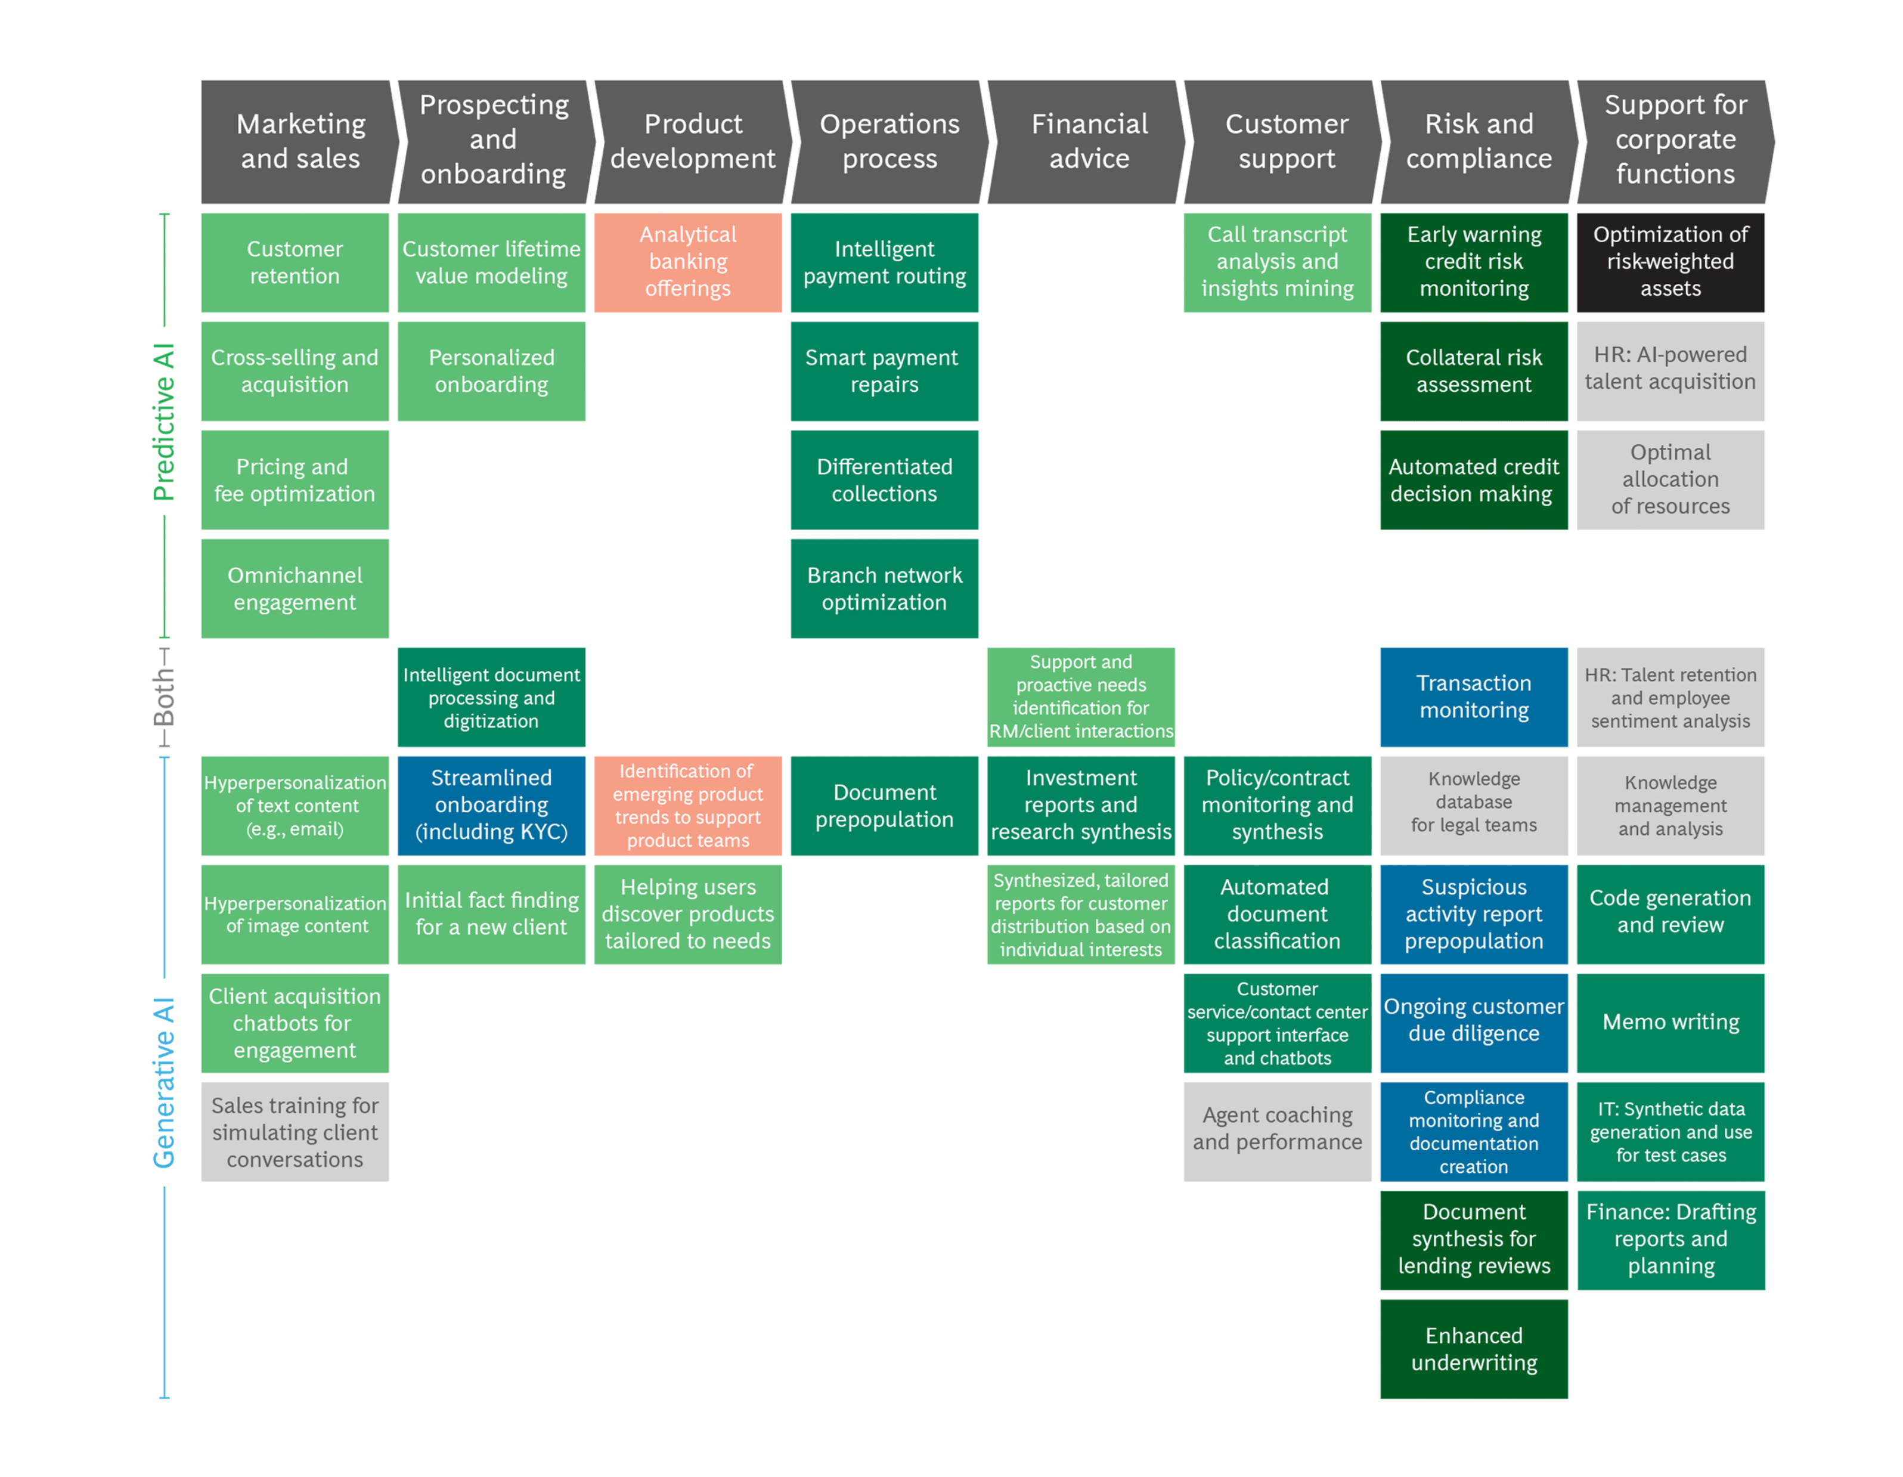
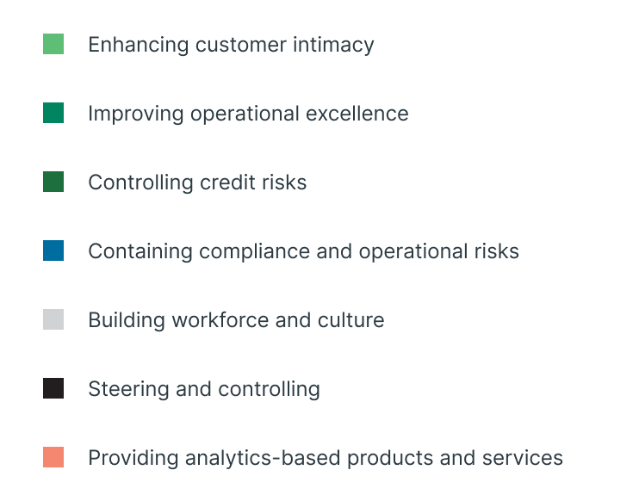
Source BCG 2020

Slide 9
Data to Voice

Slide 10
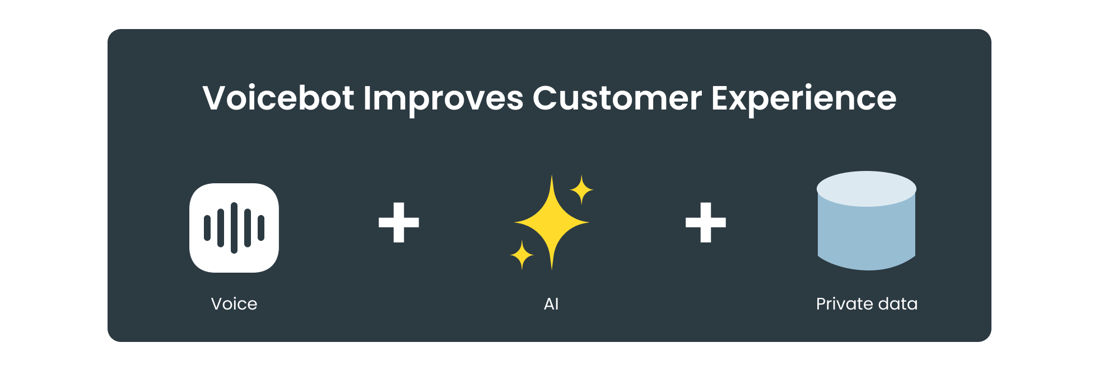
Voicebot Improves Customer Experience at Topdanmark
Increased flexibility and the customer efficiency with conversational AI
GDPR-compliant infrastructure
Integrated into Topdanmarks customer center solution
17 sec
73
58k
VOICEBOT’S AVERAGE PHONE TIME
RESOLUTION PERCENTAGE
CALLS PER DAY
Notes:
https://trifork.com/?cases=voicebot-improves-customer-experience-at-topdanmark

Slide 11
Agent Assist: Better Citizen Service with AI
Problem
Recruitment and training of new employees is a major challenge for citizen service. Transferring phone calls to specialists provides poor citizen service and is an expensive solution for the municipality.
Solution Description
Voice-controlled guide entry to the central knowledge database has reduced the training period, decreased transfers, and improved immediate resolutions. The employee has received a Personal Assistant > provides better citizen service.
Notes:
Case+Film: https://trifork.com/?portfolio=perfecting-customer-service-with-machine-learning

Slide 12
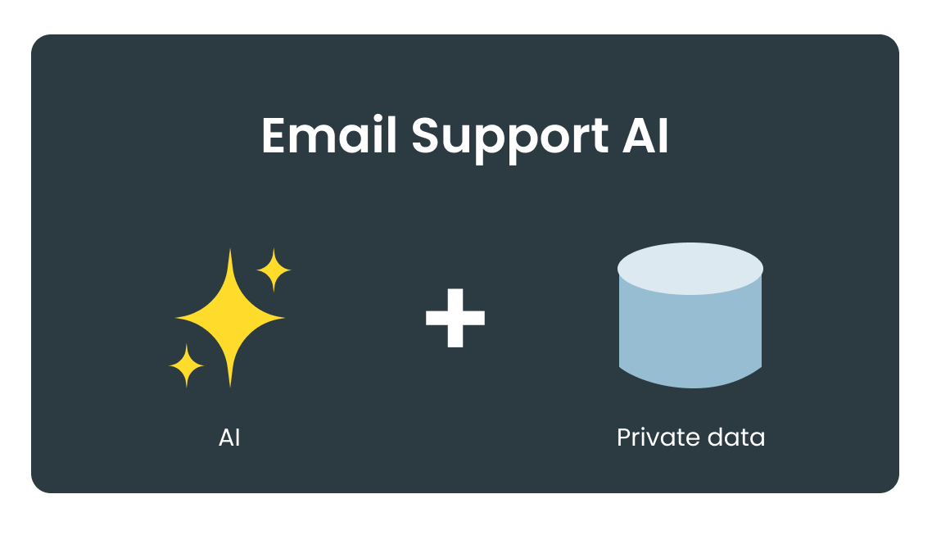
Supportmail AI-assistent
Business Challenge
Solution
Results
The number of email inquiries is growing
Time spent on answering emails is increasing
High degree of repetition
High employee turnover increases onboarding requirements
Use of Modular/Advanced RAG to match the written company knowledge against the email inquiries that come through support
The AI generates an email response that is ready as a draft directly in the support's email system - ready for sending
Initial tests show that 55% of all generated emails can be sent directly to the customer without modification

Slide 13
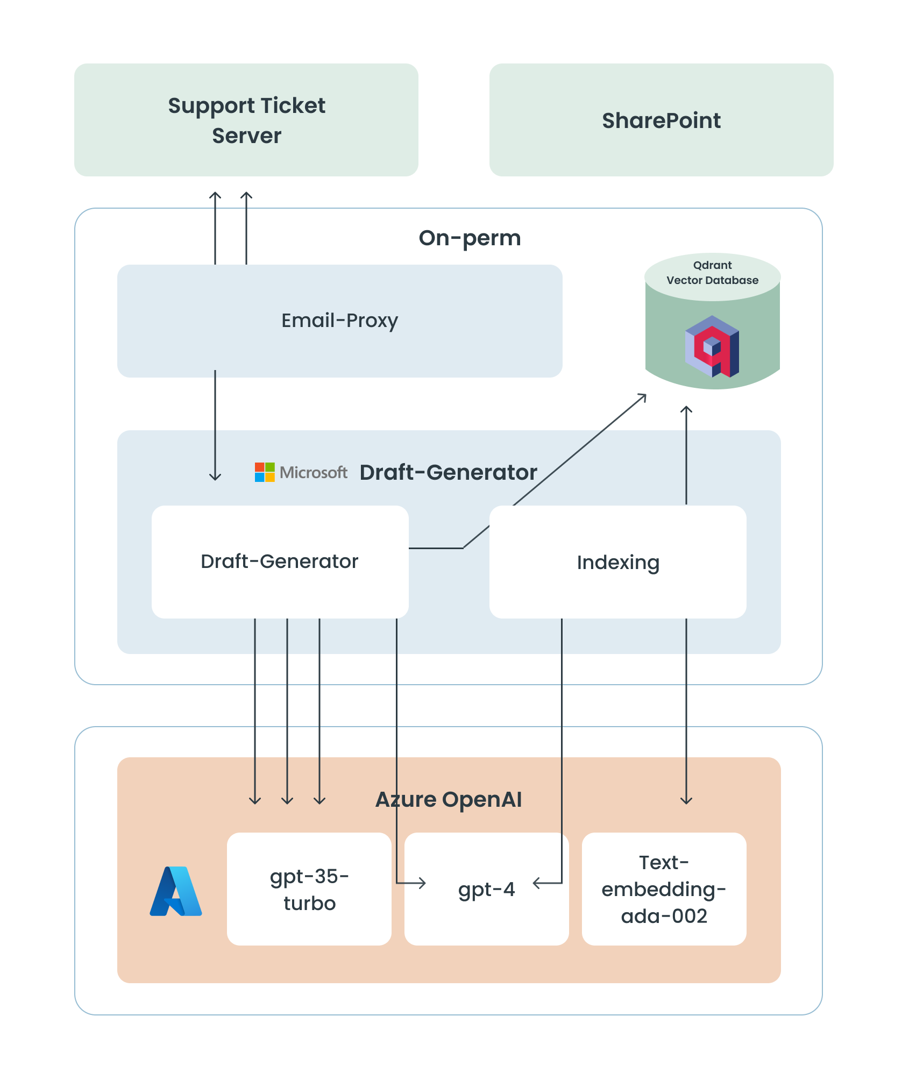
Results
Work is ongoing to improve data/guidelines in SharePoint to achieve an even higher success rate
Email Proxy:
Query and filter email tickets
Send email body to Draft generator
Apply template and attach draft to ticket
Draft Generator
Categorize and embed questions
Fetch documents from Qdrant
Answer and validate using LLM
Azure OpenAI
Fetch and preprocess documents.
Embed documents (size 1536)
Upload to Qdrant with metadata.
Notes:
Email Proxy:
Query emails tickets from email server for a given interval of time and filter away emails with exhisting drafts as well as other filters
Send email body to Draft generator
Apply template to generated draft and attach draft to given email ticket
Draft generation:
List questions from email and categorize each question in using categories from documents used in Indexing step
(a) Embed questions and (b) fetch documents from Qdrant using categories as namespace
Answer each question using LLM including retrieved documents as context Validate and combine all asnwers using LLM
Indexing:
Fetch documents from SharePoint
Preprocess each document using LLM to reduce noise
Embed documents (vector size 1536)
Upload to Qdrant with category as namespace and additional metadata

Slide 14
Data to Insights

Slide 15
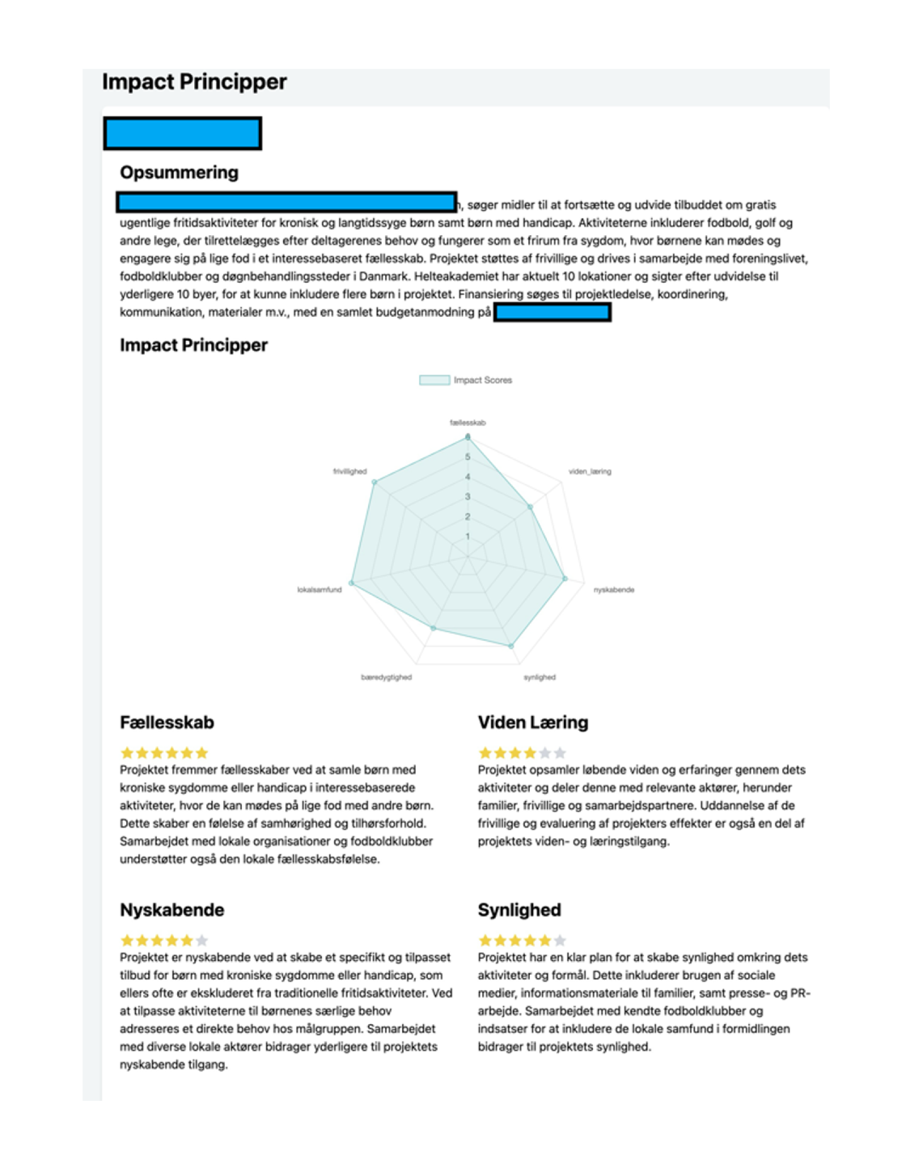
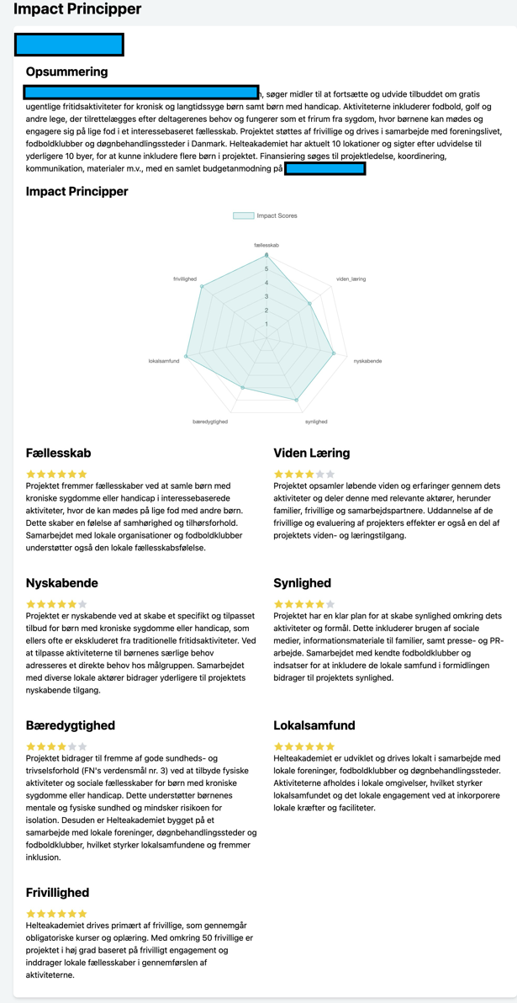
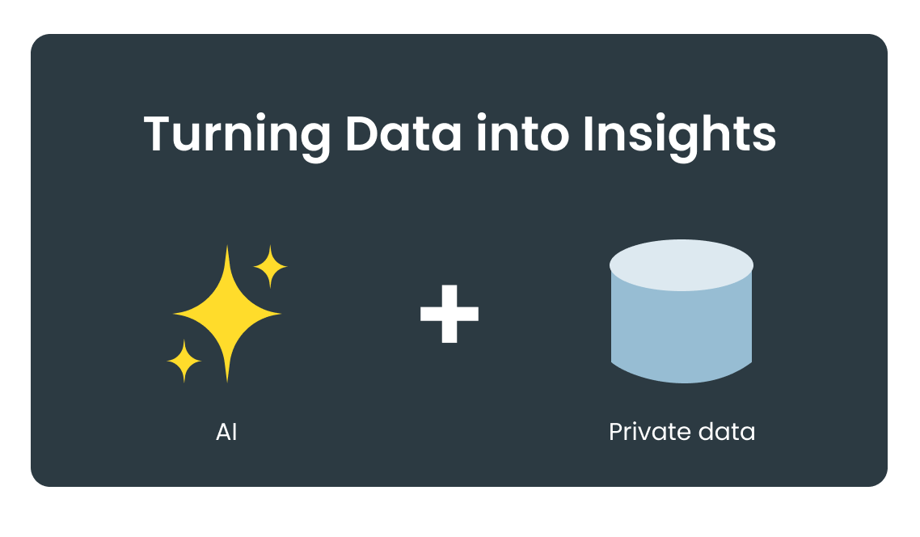
Turning Data into Insights
Analysis of financial statements, comparison with peers, red flags, and questions for the advisor.
Processing applications Receiving applications in either large volume and complexity. The AI model can create summaries and scoring according to complex criteria.
Value: Summary, Grading, Analysis etc.

Slide 16
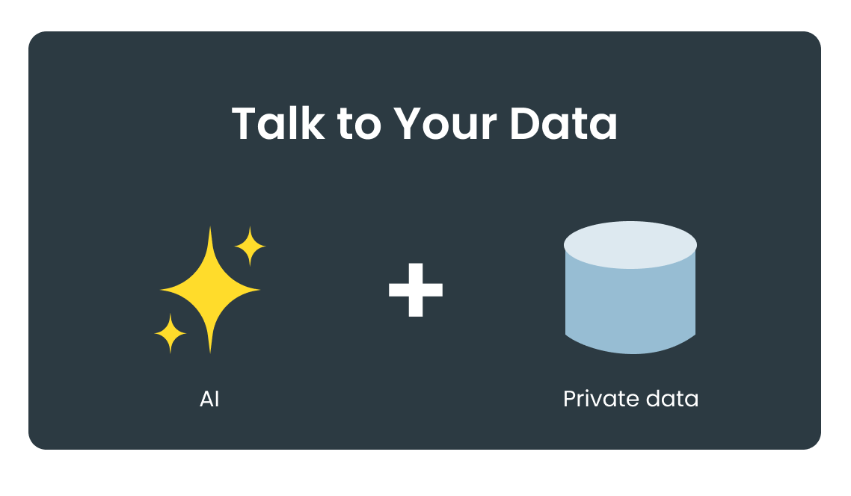
Trifork Talk to Your Data
Trifork has developed this solution "Talk to Your data." It uses OpenAI's model as the LLM
This model combines the standard Large Language Model we know from chatGPT with the customer's own information. In this case, PDF documents with financial analyses
This solution can support searching and questioning a wide range of other internal documents.

Slide 17
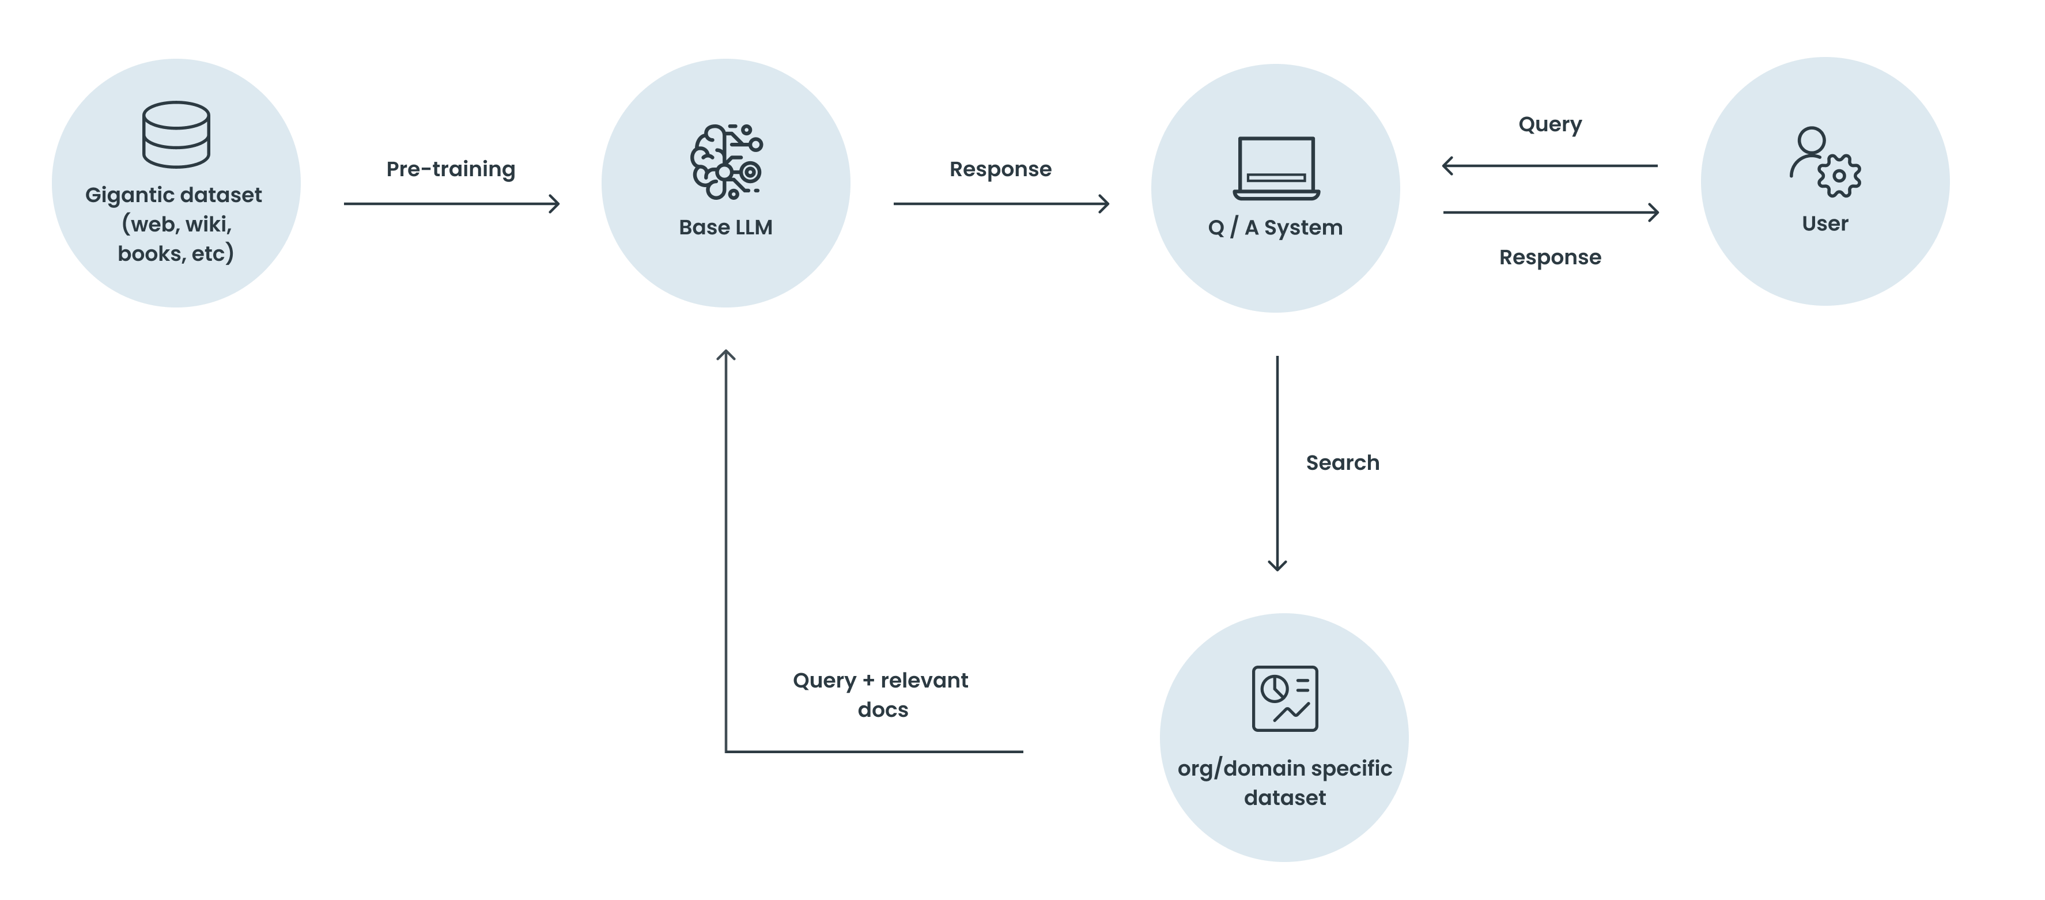
Talk to Your Data Architecture

Slide 18
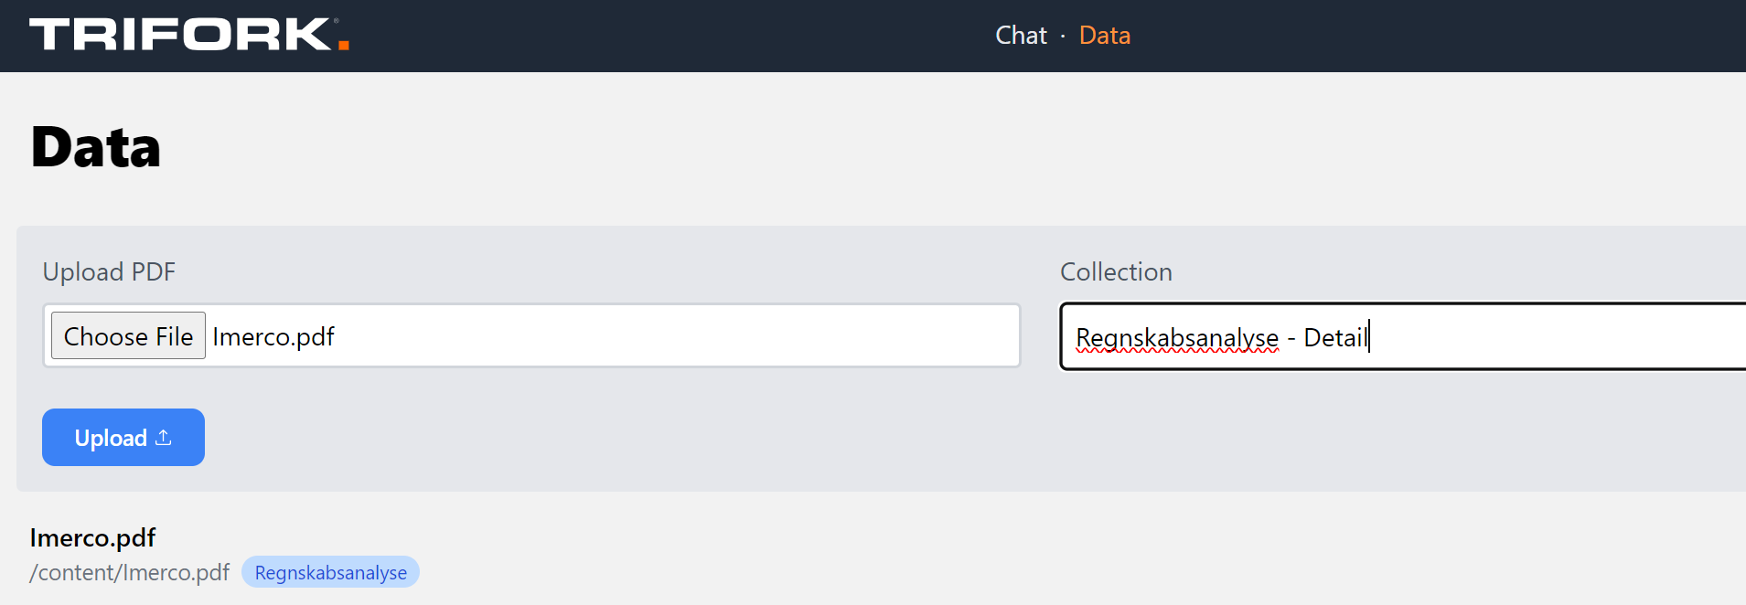
Step 1: Upload Accounting Analysis
Documents are uploaded to a Collection
AI model parses and indexes the document and makes it ready for searching. This takes about 1 minute.

Slide 19
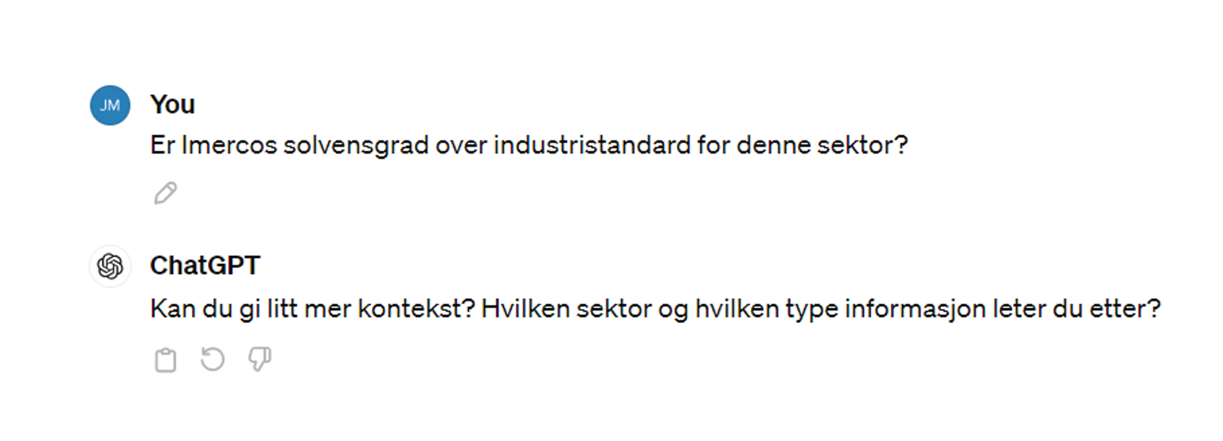
Step 2: Can chatGPT Answer That?

Slide 20
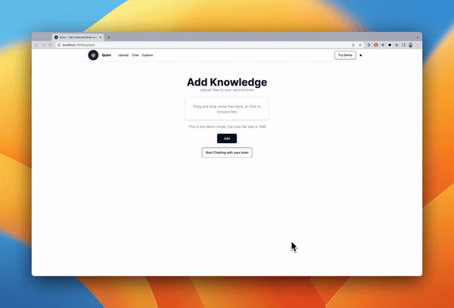
Step 3: Chat with the Accounting Analysis
Indication of the reference on which the answer is based
AI Model suggests the next questions based on the dialogue

Slide 21
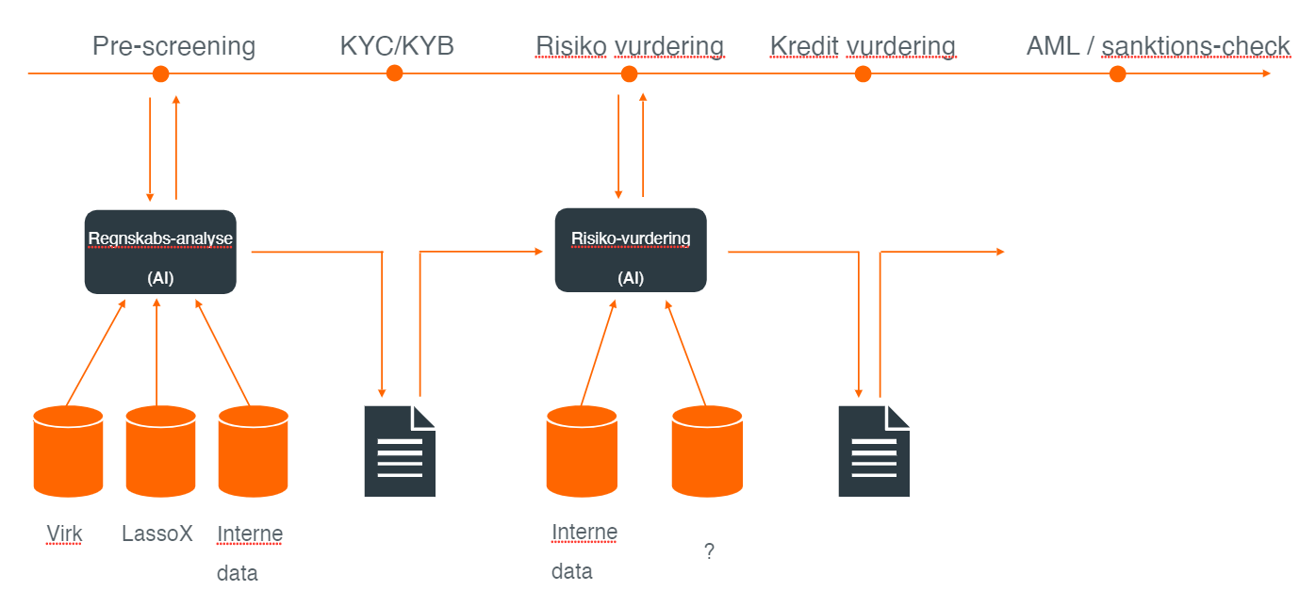
Example: Accounting analysis in credit flow
Risiko vurdering -> Risk assesment
Kredit vurdering -> Credit rating
Regnskab analyse → Accounting analysis
Interne data -> Internal data

Slide 22
Talk to Your Data AI Usecases?
Customer Support:
Training:
"How do I open a new savings account?"
"What is our protocol during a phishing attack?”
Business Report/Financial Analysis:
Troubleshooting:
”Should we invest in this company?”
”The printer do not work”
Compliance:
Legal Advice:
”Is this document GDPR compliant?"
"Can I share customer information with a third party?"
Product Knowledge:
Employee Onboarding:
""What are the benefits of our premium credit card?”
"How do I apply for vacation?"

Slide 23
Agents

Slide 24
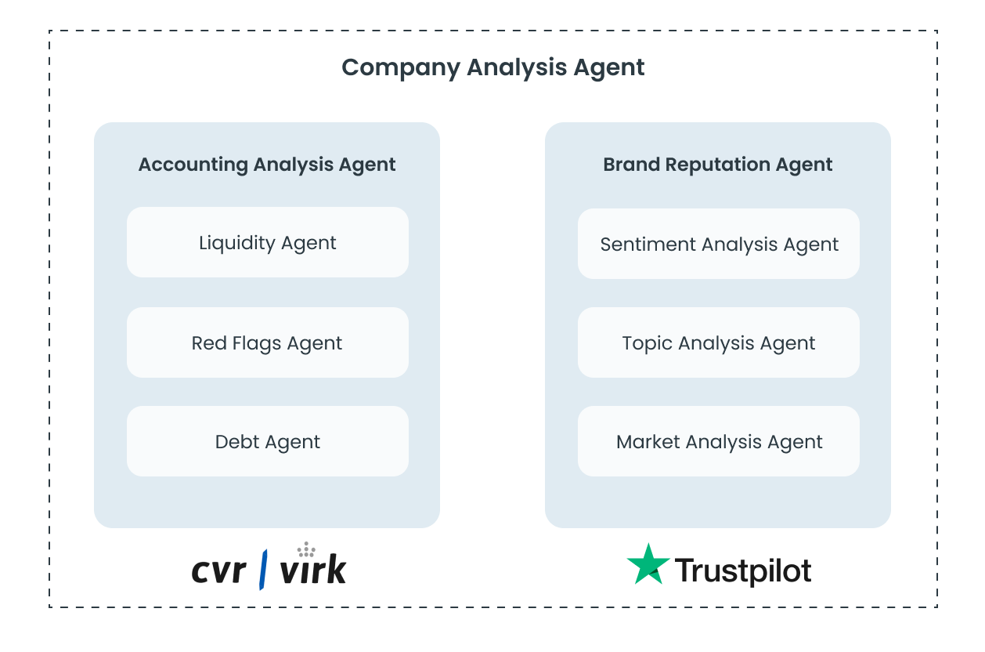
Trifork Agents
AI AGENTS
Agents solve undefined workflows through communication with each other and external tools
Examples of external tools are: company data, Trustpilot data, heavy calculations, analytics, etc
Specialized agents solve specific tasks. The data output is included in the bigger picture

Slide 25
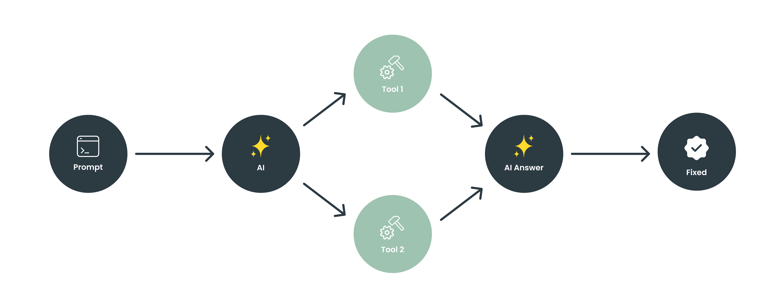
AI AGENTS

Slide 26
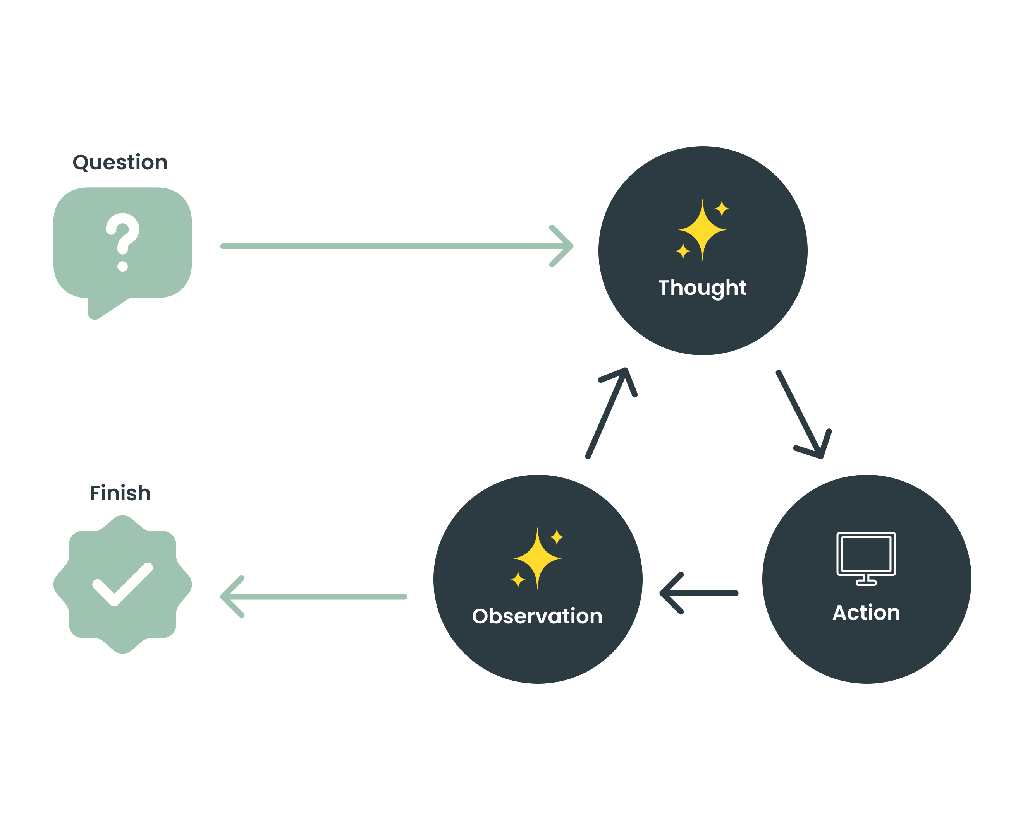
Agent Architecture
AI AGENTS

Slide 27
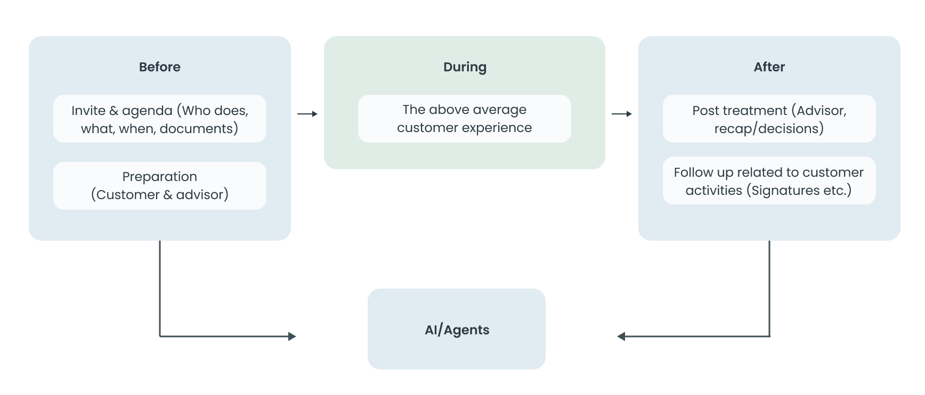
Book me meeting tool

Slide 28
Vision AI

Slide 29
Biodiversity Protection with AI
AI and Computer Vision Powered Biodiversity Protection in Scandinavia
1,844 Danish species of animals, plants, and fungus risk extinction
Protecting biodiversity by using AI to identify and mitigate invasive alien plant species along roads in Denmark, Sweden, and Iceland
Existing manual monitoring in service vehicles is sporadic and insufficient
Trifork leverages its extensive experience in AI and image analysis for this project
The solution involves vehicle-mounted cameras using AI for constant invasive alien plant species identification, enabling automatic, real-time data collection for road authorities.
Extension under way to monitor occurrence of dead animals on the roads to build preventive measures in the most affected locations

Slide 30
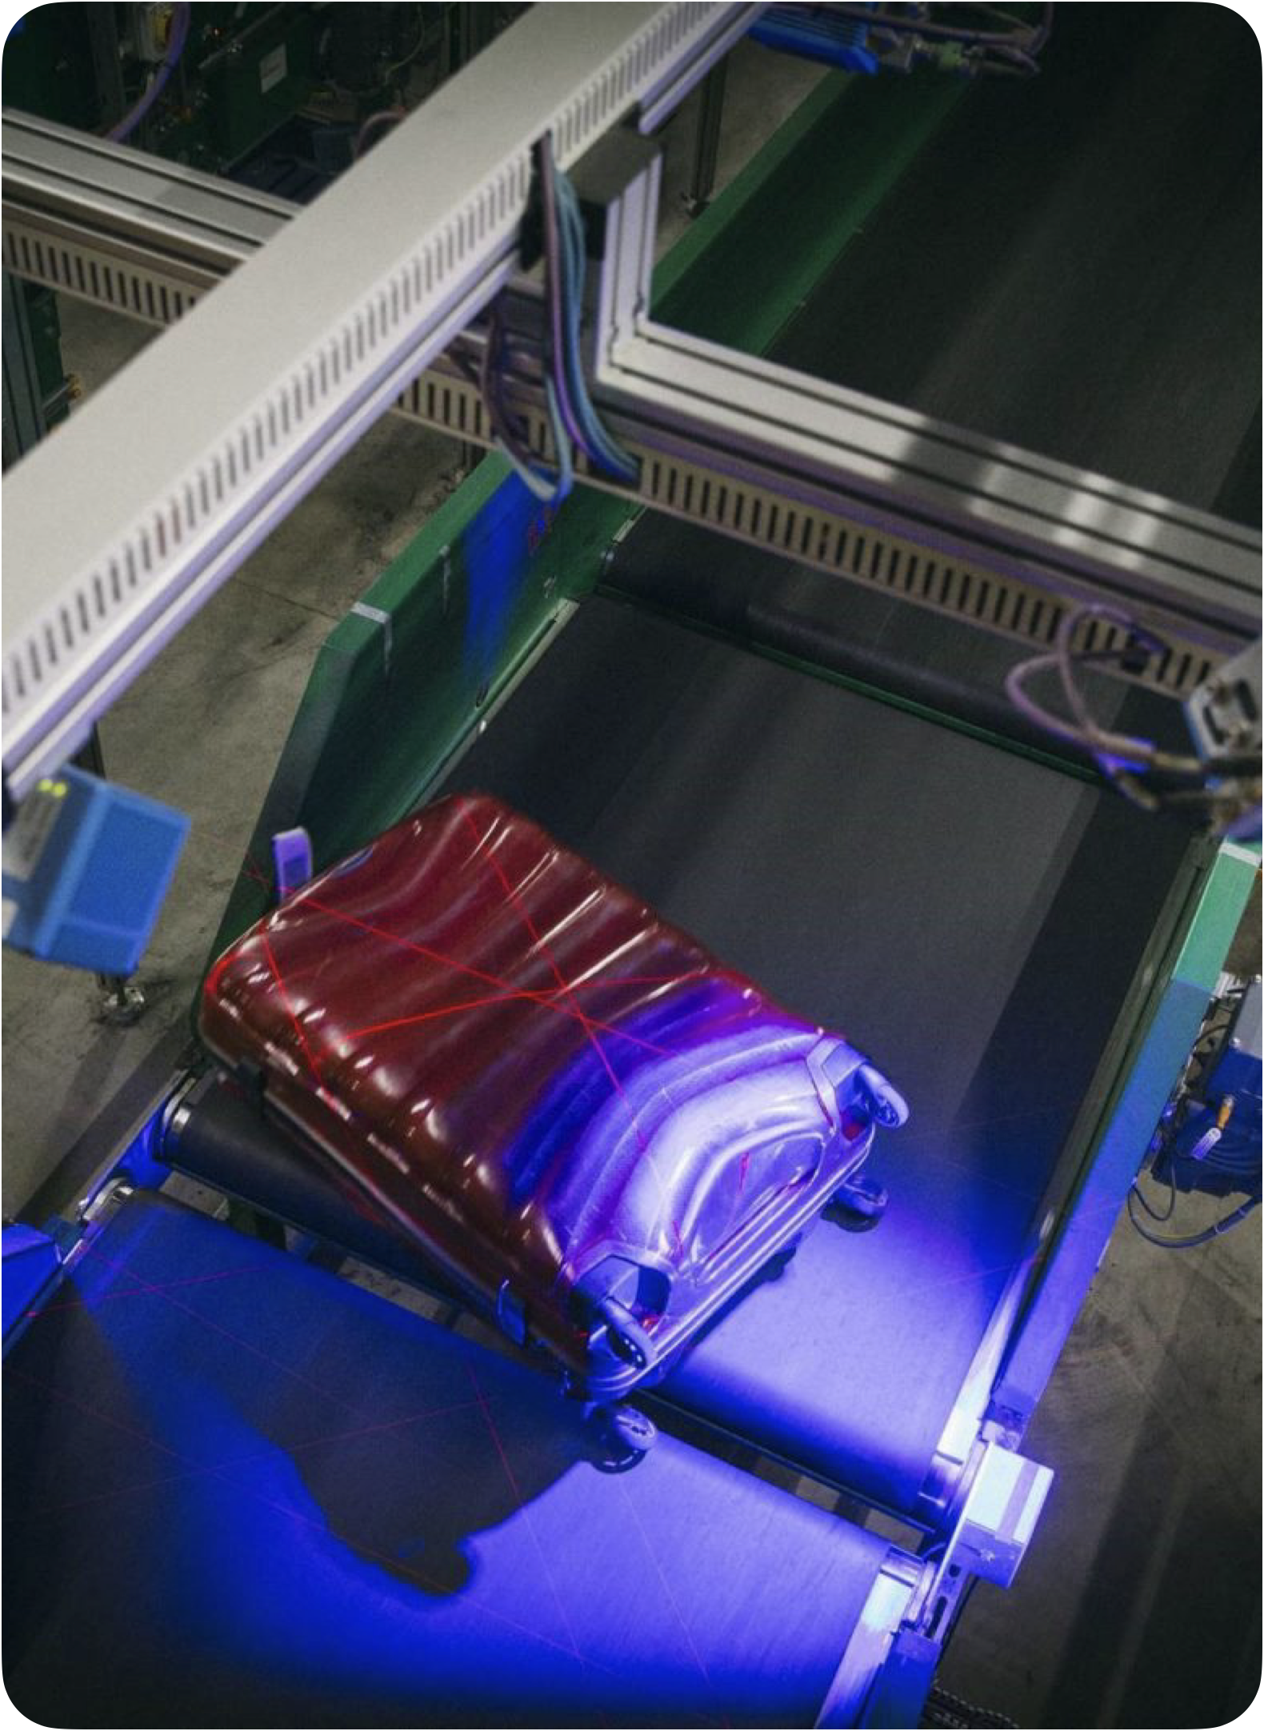
Reducing Baggage Delays with Machine Learning
Baggage identification using Machine Learning
lower the amount of lost baggage, cost efficiently
investment-effective optimisation and can easily scale to more cameras if needed
95%
98%
2
RE-IDENTIFIED BAGGAGE
TRACKING IN NON-TRACKING ZONES
CAMERAS CONNECTED

Slide 31
Quality Assurance in Real-Time
Identifying visual defects on window frames
Cross-factory standardisation of QA
40ms feedback for quick reaction and response
Decreases the amount of faulty components shipped to customers
4-camera scanner working together with Velux systems
250K
4X80
40X
PHOTOS ANALYSED
PHOTOS ANALYSED PER SECOND
FASTER THAN A HUMAN EYE

Slide 32
AI DATA Classification

Slide 33
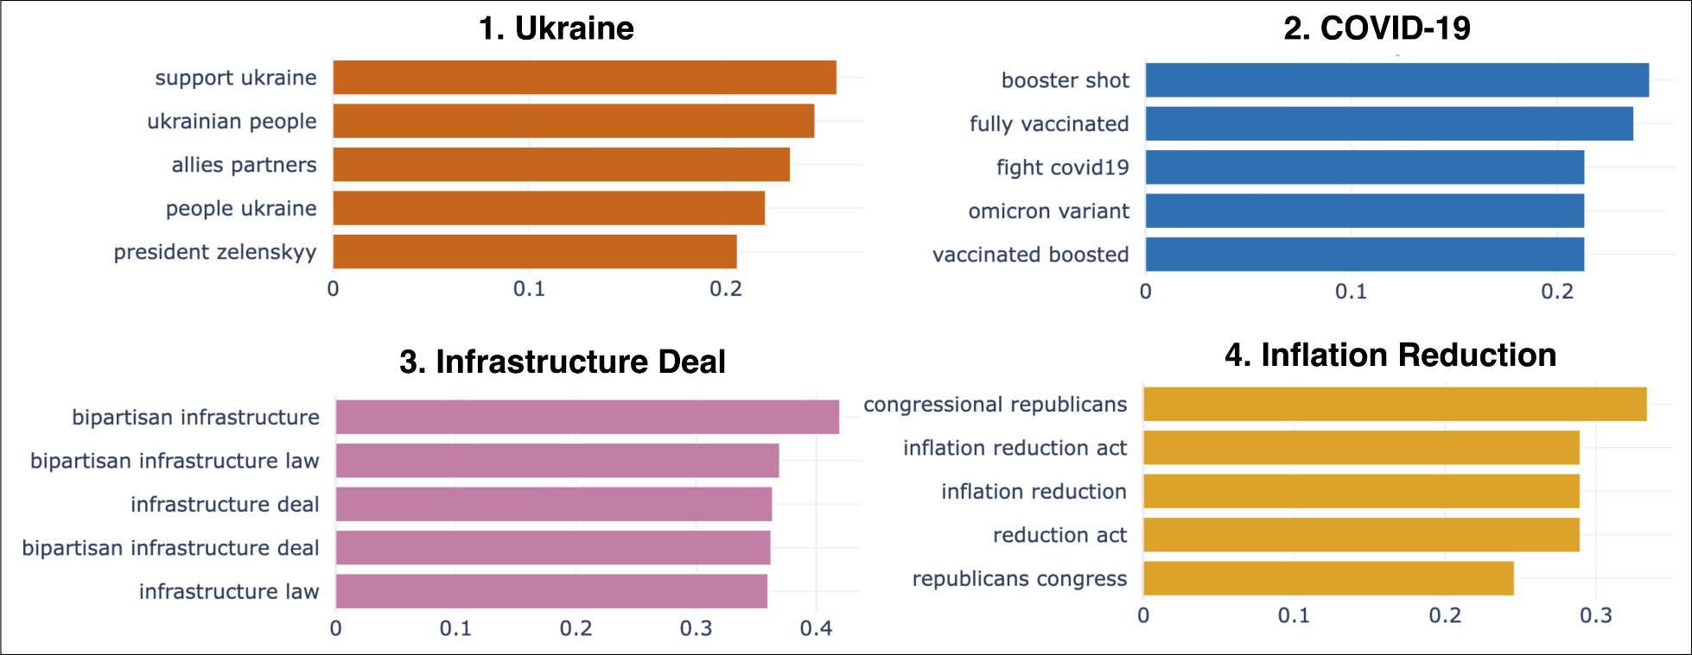
Dynamic Topic Modelling
Modellering of 3.000 tweets from Joe Biden detected 40 topics.
Notes:
Til Malthe. Disse to cases viser at vi kan læse/scrape alt information på internettet og “finde ud af hvad der snakes om”

Slide 34
Dynamic Topic Modelling – TrustPilot
Dataset
3988 holdninger/oplevelser scraped fra Trustpilot
70% positivt (4-5 stjerner), 25% negativt (1-2 stjerner), 5% neutral (3 stjerner)
Analyse

Slide 35
Dynamic Topic Modelling

Slide 36
Platform Considerations

Slide 37
Generative AI Models – Next Generation AI
Examples:
AI Foundation model of GlobalKnowledge
Chatbots / virtual assistants
AI tool pipelines
Personalised content for marketing campaigns
AI Foundation model of Local Knowledge
Generative AI Engine
Tutorial generation (personalised)
Loan Application Processing
External data sources
User-input:
Text
Video
Image
Sound
Data
Synthetic data generation for risk analysis / simulations
Private data sources
Financial Planning Support

Slide 38
BANK/ENTERPRISE – AI ARCHITECTURE
Perspective
Customer Application Landscape
CRM
Add-ons
Chat
bots
Agent assist
tools
Content generation for marketing
All applications will have AI included (Salesforce Einstein, Microsoft coPilot, etc)
Create an AI platform across your applications
Banks should focus on the Customer Application Landscape
Developing and maintaining the AI platform is not a job for a Bank
Private vs Cloud deployment?
…
API Gateway
Private AI as a Service
Classfication
Embeddings
Retrieval
Generation
Tuning
Dataplatform / Orchestration
Ingest
Processing
Storage
Access
Audit
Hosting / Infrastructure

Slide 39
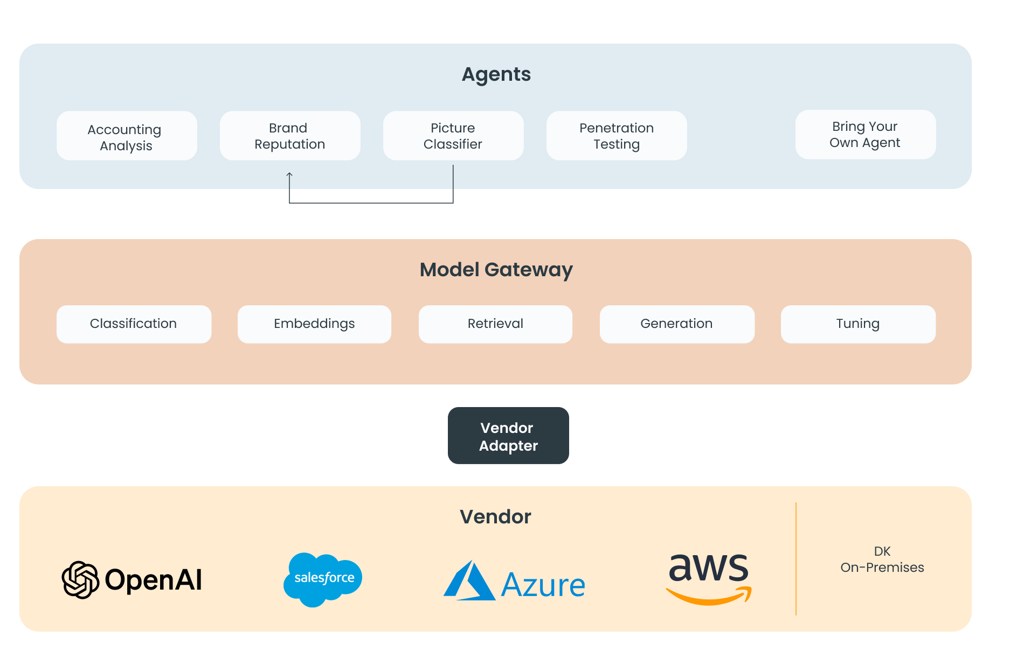
Trifork AI Platform
AI PLATFORM
Avoid vendor lock-in/Replacing models
Trifork Agents are build on the same interface and is capable of inter-communicating
Approved to be implemented on Salesforce, AWS or Microsoft
Similar interface across the models indepentdently of the vendor
“No-code” vendor switchover, or when switching from cloud to on-premises

