Slide 1



CORAX AI
Enabling customers
to harvest full potential of AI in
their business
Easy
Safe
Low
Code

Slide 2
Corax Product Suite
Corax AI – AI Enablement Platform
Development and deployment of GenAI solutions
Corax Data – Data and Integration Platform
Empower organizations to make data-driven decisions across all applications
Corax Vision – Vision AI platform
Vision AI platform for solutions like quality control, passenger counts, production and more
Corax
AI
Corax
Data
Corax
Vision

Slide 3

Corax AI
CORAX AI
A tooling platform that makes it faster, easier and more secure to implement AI solutions in your organisation to optimise processes and generate revenue.
Notes:
“...equipping individuals and organizations with the necessary knowledge, skills, data, tools, and resources to effectively utilize artificial intelligence (AI) technologies...”
Fra finanswatch artiklen:
Hvis man vil have fuldt udbytte af AI og sikre sig en konkurrencedygtig position også på langt sigt, er det min anbefaling, at man fokuserer på følgende:
Strategisk anvendelse af data og vision: Skaf overblik over hvilke data virksomheden har og formuler en vision for, hvad I vil opnå med AI. Dette vil hjælpe jer til at kanalisere investeringerne derhen, hvor de skaber den størst mulige værdi.
Gå i samarbejde med de rette eksperter: Træk på rådgivning og ekspertviden fra relevante it-leverandører, som kan hjælpe jer med at implementere AI på en effektiv og sikker måde, især hvis I mangler interne kompetencer.
Udfordringer:
Data management
Quality, Integration, Privacy, Security
Skills / talent shortage
Ressource allocation
Time, capital, people
Long-term vs. short-term focus
-----
From 'toy examples' to 'production’
Integration with existing infrastructure and services (incl. data access mgmt.)
Performance: Robustness and availability
Security: GDPR, correctness, misuse, leakage, inappropriate responses
Scaling to hundreds of AI enabled workflows
Efficient development and maintenance of new AI capabilities
Efficient development and maintenance of AI enabled workflows
Monitoring and operation of AI-based services (incl. token cost)
LLM management (incl. prompt mgmt)

Slide 4





Problems solved by using Corax AI
All challenges verified by customers that started AI implementation
BENEFITS OF USING CORAX AI
AI in production. Take AI from Data science to production
Scalable AI in organization, enterprise development
Security & Compliance
Using local LLMs
or Cloud or both?
Management
of cost
Keeping up with AI development
Notes:
Taget ud:
Providing access to the benefits
of GenAI for individuals and organizations
Development by configuration.
Reducing development cost and time – smaller AI enablement team
… by enabling individuals and organizations
to efficiently configure and deploy safe and scalable AI solutions

Slide 5


Corax AI Users
CORAX AI
Understands user needs and prioritizes tasks
Responsible for AI strategy, security and implementation
Tech-savvy, experiments with AI solutions
Builds and integrates AI into systems
Domain expert
CTO & CISO
AI-specialist
Software/AI developer
Tailored AI solutions that address business needs without technical complexity
Structured output & integration for seamless data handling
Insights & optimization of AI performance for better decision-making
Flexible AI that can be adapted to different workflows
Seamless integration with existing systems
Easy maintenance and scalability
Ensures compliance with security and regulatory standards (EU – AI Act)
Flexible AI for empowered workflows
Fast and flexible AI development with Corax tools
Performance evaluation to prevent AI errors
Easily switch and evaluate new LLMs
Easy integration with systems and APIs
Automates structured data output
Flexible output formats tailored to needs

Slide 6










Features in Corax AI
CORAX AI
BUILD YOUR AI capabilities
Build your AI capabilities
Create, configure and maintain AI capabilities for specific purposes.
Build a custom knowledge library
Create knowledge collections with company guidelines, documentation, and other essential information for AI-assisted tasks.
Multimodal
Supports various file formats, including images, PDFs, and structured data outputs. More formats, such as audio, are already planned.
Evaluate your AI
Provides tools to assess and refine AI performance to prevent errors and improve accuracy.
Gain insights into which capabilities are most utilized
Provides insights into each capability’s input and output through Langfuse.
INTEGRATION & SECURITY
API first ensuring seamless integration
Serves as a layer between AI systems and existing workflows, enabling easy configuration, deployment, and monitoring.
Scalability & Security (AD integration, active directory, ENTRA)
Designed to be scalable, secure, and cost-effective, facilitating the transition of AI from data science to real-world applications.
ML Ops & Dashboards
Integrates with DevOps tools for monitoring calls, latency, costs, and load balancing. Includes security features to protect against prompt injection, detect data leakage, and moderate content.
Model Deployment so you can use any AI model
Work with any AI model, whether cloud-based or on-premise, giving full flexibility over AI infrastructure.
Collaborate with others
Export and import capabilities so collaboration across your
organization is easier.
Notes:
Hvis vi skulle præsentere i dag, hvordan vil det se ud.
Collaboration punkt (export)
Use icons from menu (capabilites, knowledge collections)

Slide 7







Workflows already supported
CORAX AI
Project/Account/Customer Summaries
Your
use cases
Meeting Summaries
Document evaluation
Credit scoring
Applications (job/funds/loan)
Supplier contracts
Sentiment Analysis
App Store/Customer support/Trust Pilot
Answering customer emails and ratings
Chat-Bots/ Talk to Your Data
Notes:
Frigør tid
Un-biased
Bedre Compliance
Skarpere datagrundlag til optimering og insigt

Slide 8
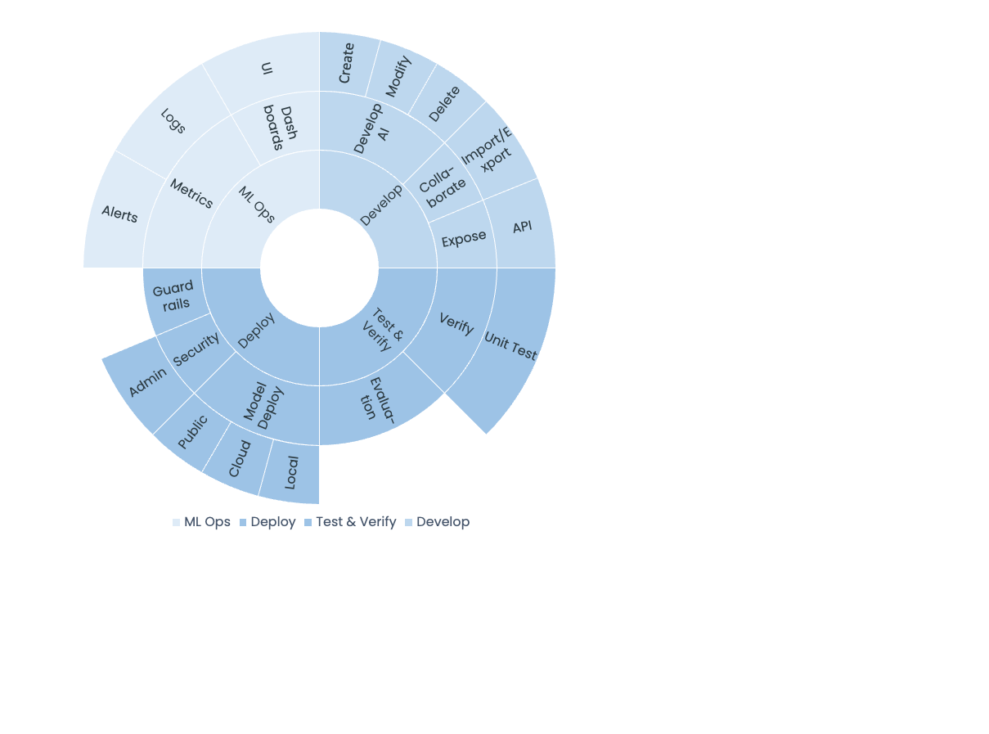

Slide 9


