Slide 1



CORAX AI
Enabling customers
to harvest full potential of AI in
their business
Easy
Safe
Low
Code

Slide 2
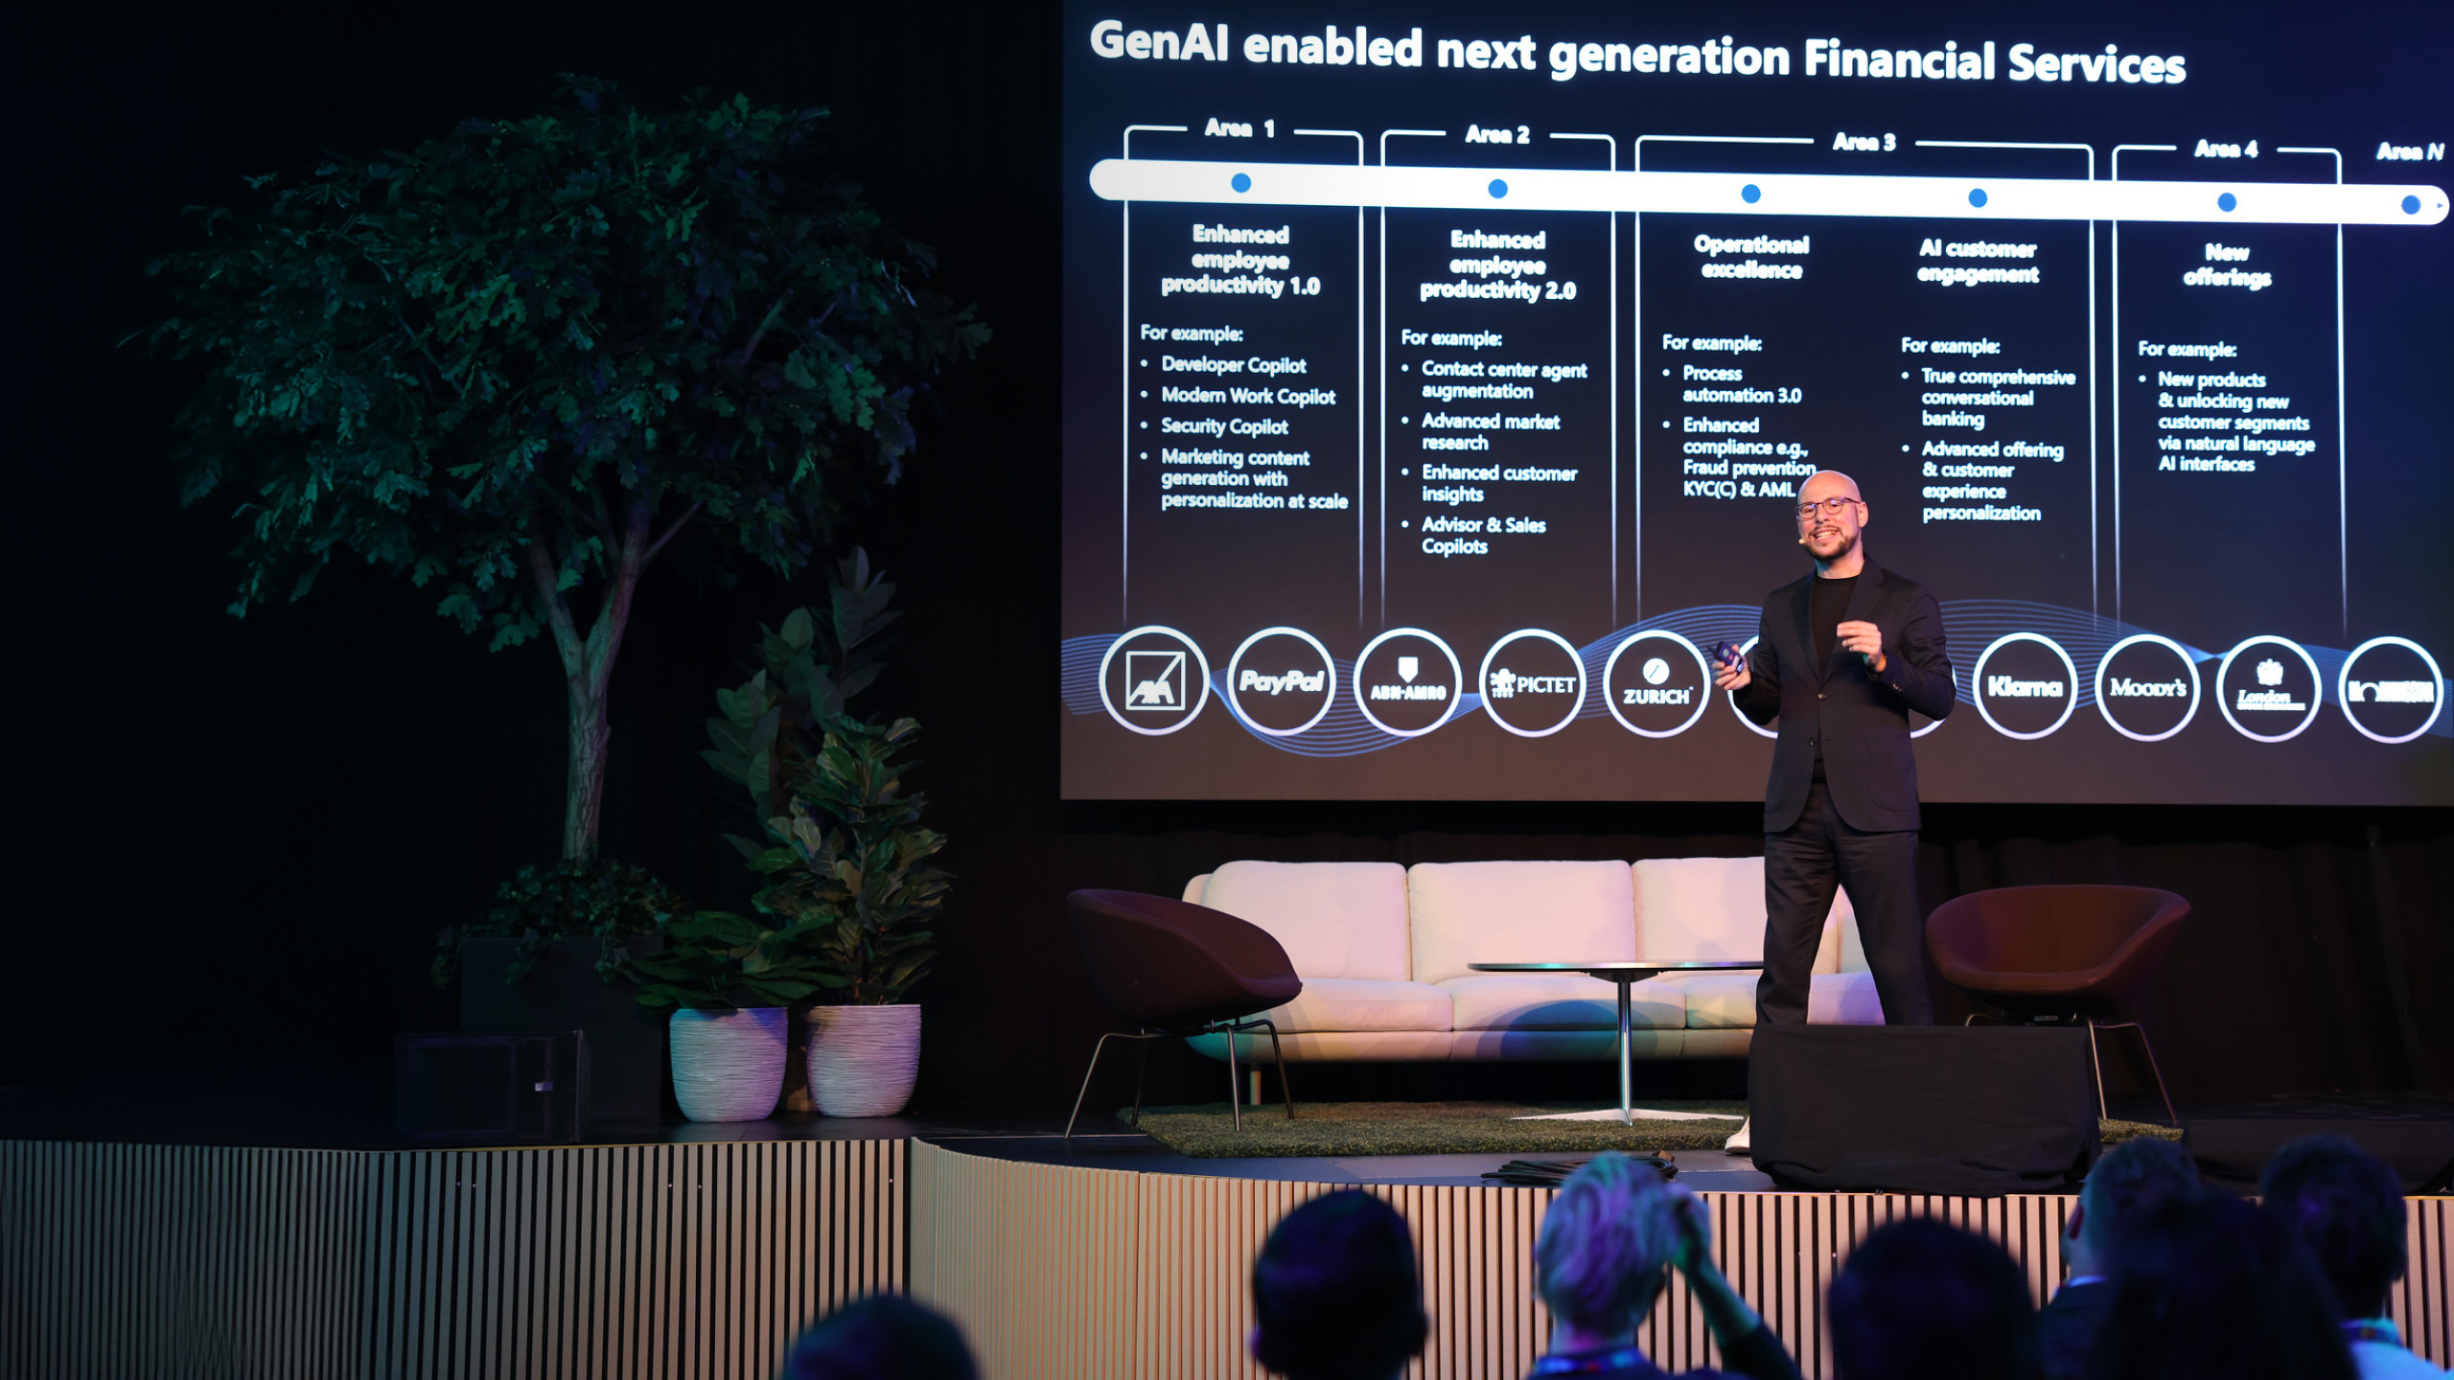

AI challenges
Notes:
Faster than you think
Tech is ready
Don’t need to look for projects. Same tasks you had the last 10 years
Martin Møller, Head of AI, Microsoft FSI EMEA at Nordic Fintech Week
Teknologien er klar…
Implementeringen går hurtigere end du tror…
Problemerne vi kan løse er de problemer I har bøvlet med de sidste 15 år…
Skriv disse med hvidt til venstra. Sæt Microsoft Logo på

Slide 3
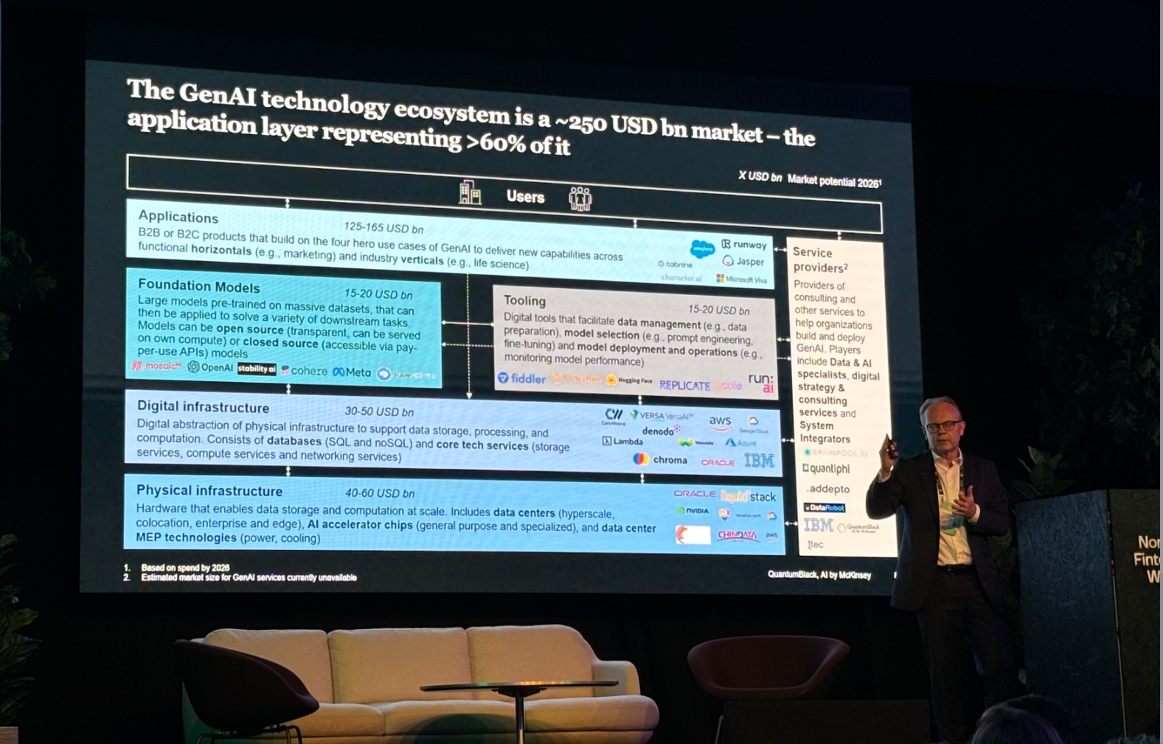

Notes:
From 'toy examples' to 'production’
Integration with existing infrastructure and services (incl. data access mgmt.)
Performance: Robustness and availability
Security: GDPR, correctness, misuse, leakage, inappropriate responses
Scaling to hundreds of AI enabled workflows
Efficient development and maintenance of new AI capabilities
Efficient development and maintenance of AI enabled workflows
Monitoring and operation of AI-based services (incl. token cost)
LLM management (incl. prompt mgmt)

Slide 4
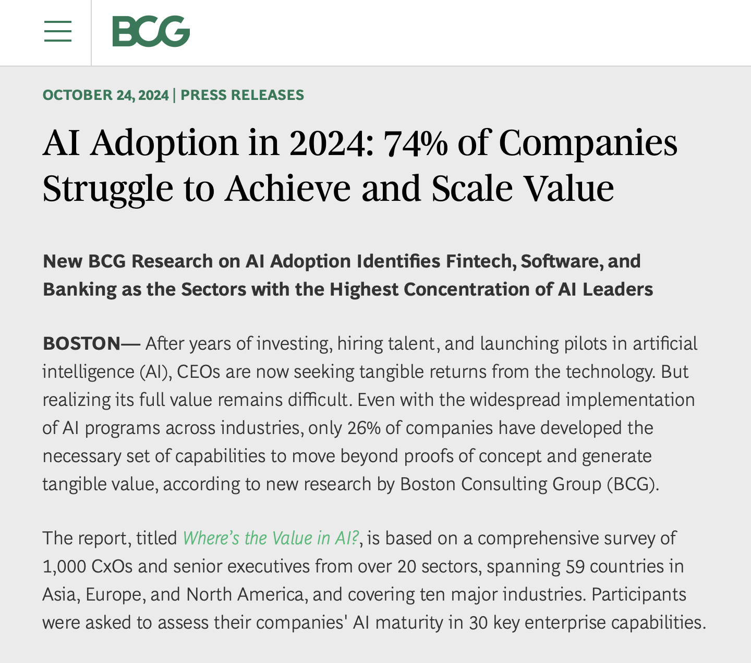
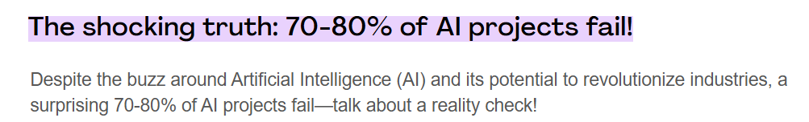
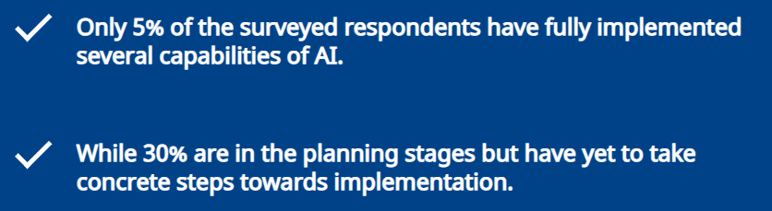
AI enablement
CORAX AI
Project Management Institute, Dec, 2024
BCG, 2024 – Danish Companies:
Notes:
Fra finanswatch artiklen:
Hvis man vil have fuldt udbytte af AI og sikre sig en konkurrencedygtig position også på langt sigt, er det min anbefaling, at man fokuserer på følgende:
Strategisk anvendelse af data og vision: Skaf overblik over hvilke data virksomheden har og formuler en vision for, hvad I vil opnå med AI. Dette vil hjælpe jer til at kanalisere investeringerne derhen, hvor de skaber den størst mulige værdi.
Gå i samarbejde med de rette eksperter: Træk på rådgivning og ekspertviden fra relevante it-leverandører, som kan hjælpe jer med at implementere AI på en effektiv og sikker måde, især hvis I mangler interne kompetencer.
Udfordringer:
Data management
Quality, Integration, Privacy, Security
Skills / talent shortage
Ressource allocation
Time, capital, people
Long-term vs. short-term focus
-----
From 'toy examples' to 'production’
Integration with existing infrastructure and services (incl. data access mgmt.)
Performance: Robustness and availability
Security: GDPR, correctness, misuse, leakage, inappropriate responses
Scaling to hundreds of AI enabled workflows
Efficient development and maintenance of new AI capabilities
Efficient development and maintenance of AI enabled workflows
Monitoring and operation of AI-based services (incl. token cost)
LLM management (incl. prompt mgmt)

Slide 5
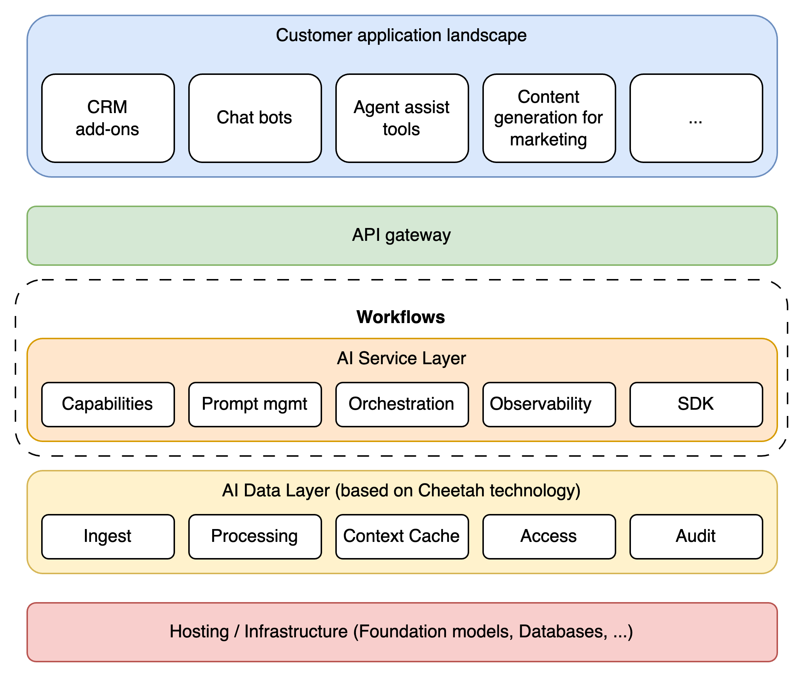
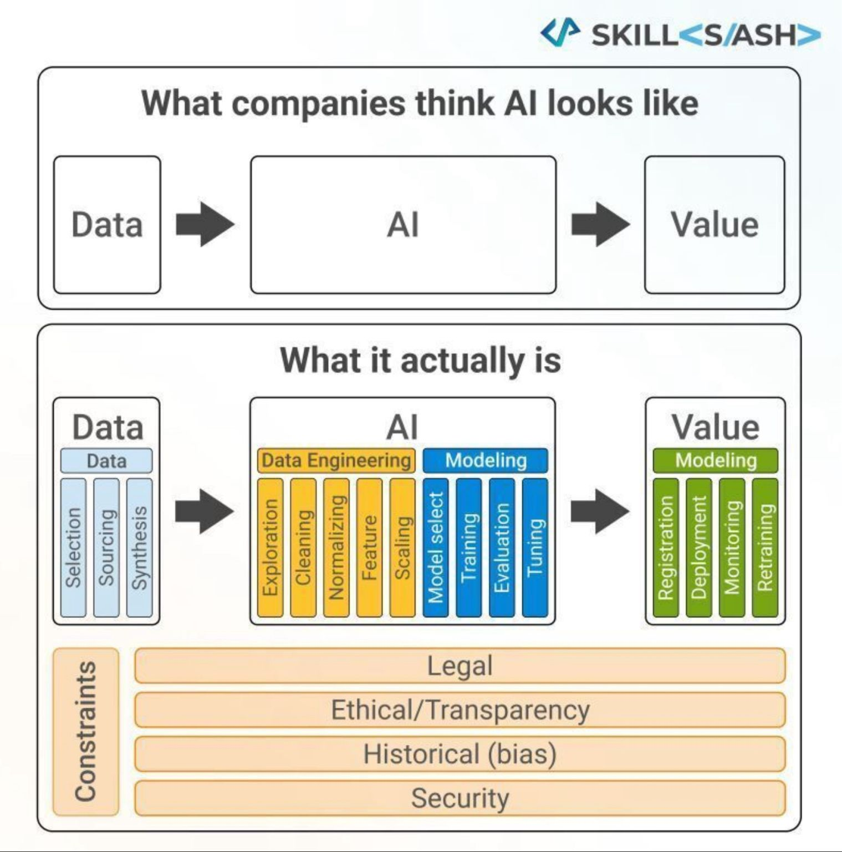
CORAX AI
The AI implementation challenge
Easy
Safe
Low
Code
Notes:
Støjer for meget pt

Slide 6





Challenges verified by customers that started AI development & implementation
BENEFITS OF USING CORAX
AI in production. Take AI from Data science to production
Scalable AI in organization, enterprise development
Security & Compliance
Using local LLMs
or Cloud or both?
Management
of cost
Notes:
Taget ud:
Providing access to the benefits
of GenAI for individuals and organizations
Development by configuration.
Reducing development cost and time – smaller AI enablement team
… by enabling individuals and organizations
to efficiently configure and deploy safe and scalable AI solutions

Slide 7

What everybody needs is…
CORAX AI
A tooling platform that makes it faster, easier and more secure to implement AI solutions in your organisation to optimise processes and generate revenue.
Notes:
“...equipping individuals and organizations with the necessary knowledge, skills, data, tools, and resources to effectively utilize artificial intelligence (AI) technologies...”
Fra finanswatch artiklen:
Hvis man vil have fuldt udbytte af AI og sikre sig en konkurrencedygtig position også på langt sigt, er det min anbefaling, at man fokuserer på følgende:
Strategisk anvendelse af data og vision: Skaf overblik over hvilke data virksomheden har og formuler en vision for, hvad I vil opnå med AI. Dette vil hjælpe jer til at kanalisere investeringerne derhen, hvor de skaber den størst mulige værdi.
Gå i samarbejde med de rette eksperter: Træk på rådgivning og ekspertviden fra relevante it-leverandører, som kan hjælpe jer med at implementere AI på en effektiv og sikker måde, især hvis I mangler interne kompetencer.
Udfordringer:
Data management
Quality, Integration, Privacy, Security
Skills / talent shortage
Ressource allocation
Time, capital, people
Long-term vs. short-term focus
-----
From 'toy examples' to 'production’
Integration with existing infrastructure and services (incl. data access mgmt.)
Performance: Robustness and availability
Security: GDPR, correctness, misuse, leakage, inappropriate responses
Scaling to hundreds of AI enabled workflows
Efficient development and maintenance of new AI capabilities
Efficient development and maintenance of AI enabled workflows
Monitoring and operation of AI-based services (incl. token cost)
LLM management (incl. prompt mgmt)

Slide 8


Corax AI Users
CORAX AI
Understands user needs and prioritizes tasks
Responsible for AI strategy, security and implementation
Tech-savvy, experiments with AI solutions
Builds and integrates AI into systems
Domain expert
CTO & CISO
AI-specialist
Software/AI developer
Tailored AI solutions that address business needs without technical complexity
Structured output & integration for seamless data handling
Insights & optimization of AI performance for better decision-making
Flexible AI that can be adapted to different workflows
Seamless integration with existing systems
Easy maintenance and scalability
Ensures compliance with security and regulatory standards (EU – AI Act)
Flexible AI for empowered workflows
Fast and flexible AI development with Corax tools
Performance evaluation to prevent AI errors
Easily switch and evaluate new LLMs
Easy integration with systems and APIs
Automates structured data output
Flexible output formats tailored to needs

Slide 9
Where to start with AI?
Remember the statement from Microsoft Head of AI

Slide 10
Suggested AI implementation roadmap
CORAX AI
Autonomous AI workflows (“Agents”)
Extend AI flows to external partners / customers
Core principles
Start simple with low risk
Slowly add complexity while keeping risk acceptable
Complex internal workflows
Simple internal workflows
Notes:
Re-design model (Inspiration 2021.ai)
Core principle: Start simple with low risk. Slowly add complexity while keeping risk acceptable.
Focus on automation of (internal) workflows. Start with simple workflow steps that are repetitive and time-consuming (no need to change your processes or structures)
Move on to more internal complex workflows and get experience with handling ‘edge’-cases with AI
Extend you AI solutions (i.e. automate beyond your internal workflows towards your external partners in your supply chain and towards your customers)

Slide 11

WHERE TO START WITH AI
High optimism and excitement around GenAI potential
A Boston Consulting Group report from 2024 shows that 81% of Danish executives foresee generative AI to have a favourable influence on their businesses
Yet 5% have gone beyond POC stage and integrated AI in daily operation.
Boston Consulting Group, 2024
Notes:
Citat her fra: https://investindk.com/insights/boston-consulting-group-reveals-strong-belief-in-generative-ai-among-danish-leaders

Slide 12
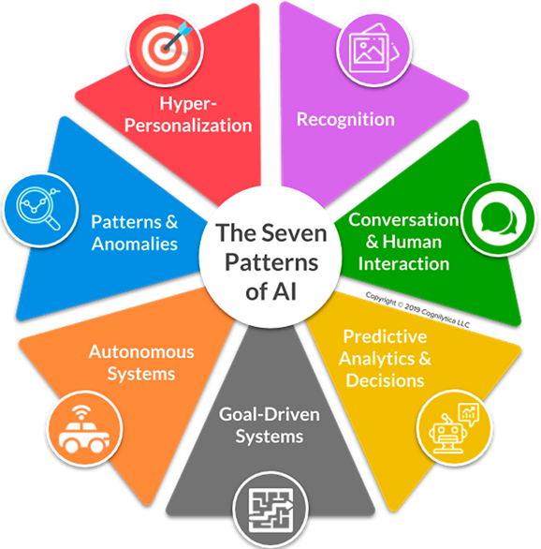



AI Workshop Scope
CLIENT NAME
Inspiration
Inspirational presentation about the value-creating opportunities within AI.
Inspirational cases from other companies
Mapping
Systematic idea generation, which ensures that all relevant issues are processed across job functions – including use of all relevant AI technologies
Validation and priorities
Potentials are categorized and prioritized based on business value. The highest priority ideas are further validated from a technical, ethical and correctness perspective. Further work is being done with business cases.
Notes:
Denne workshop hjælper os med at spotte forretningsudfordringer og muligheder, hvor kunstig intelligens (AI) kan gøre en forskel. Med mulighedskort i hånden brainstormer vi idéer, dykker ned i de mest lovende og sammenligner dem for at finde de bedste at arbejde videre med.

Slide 13
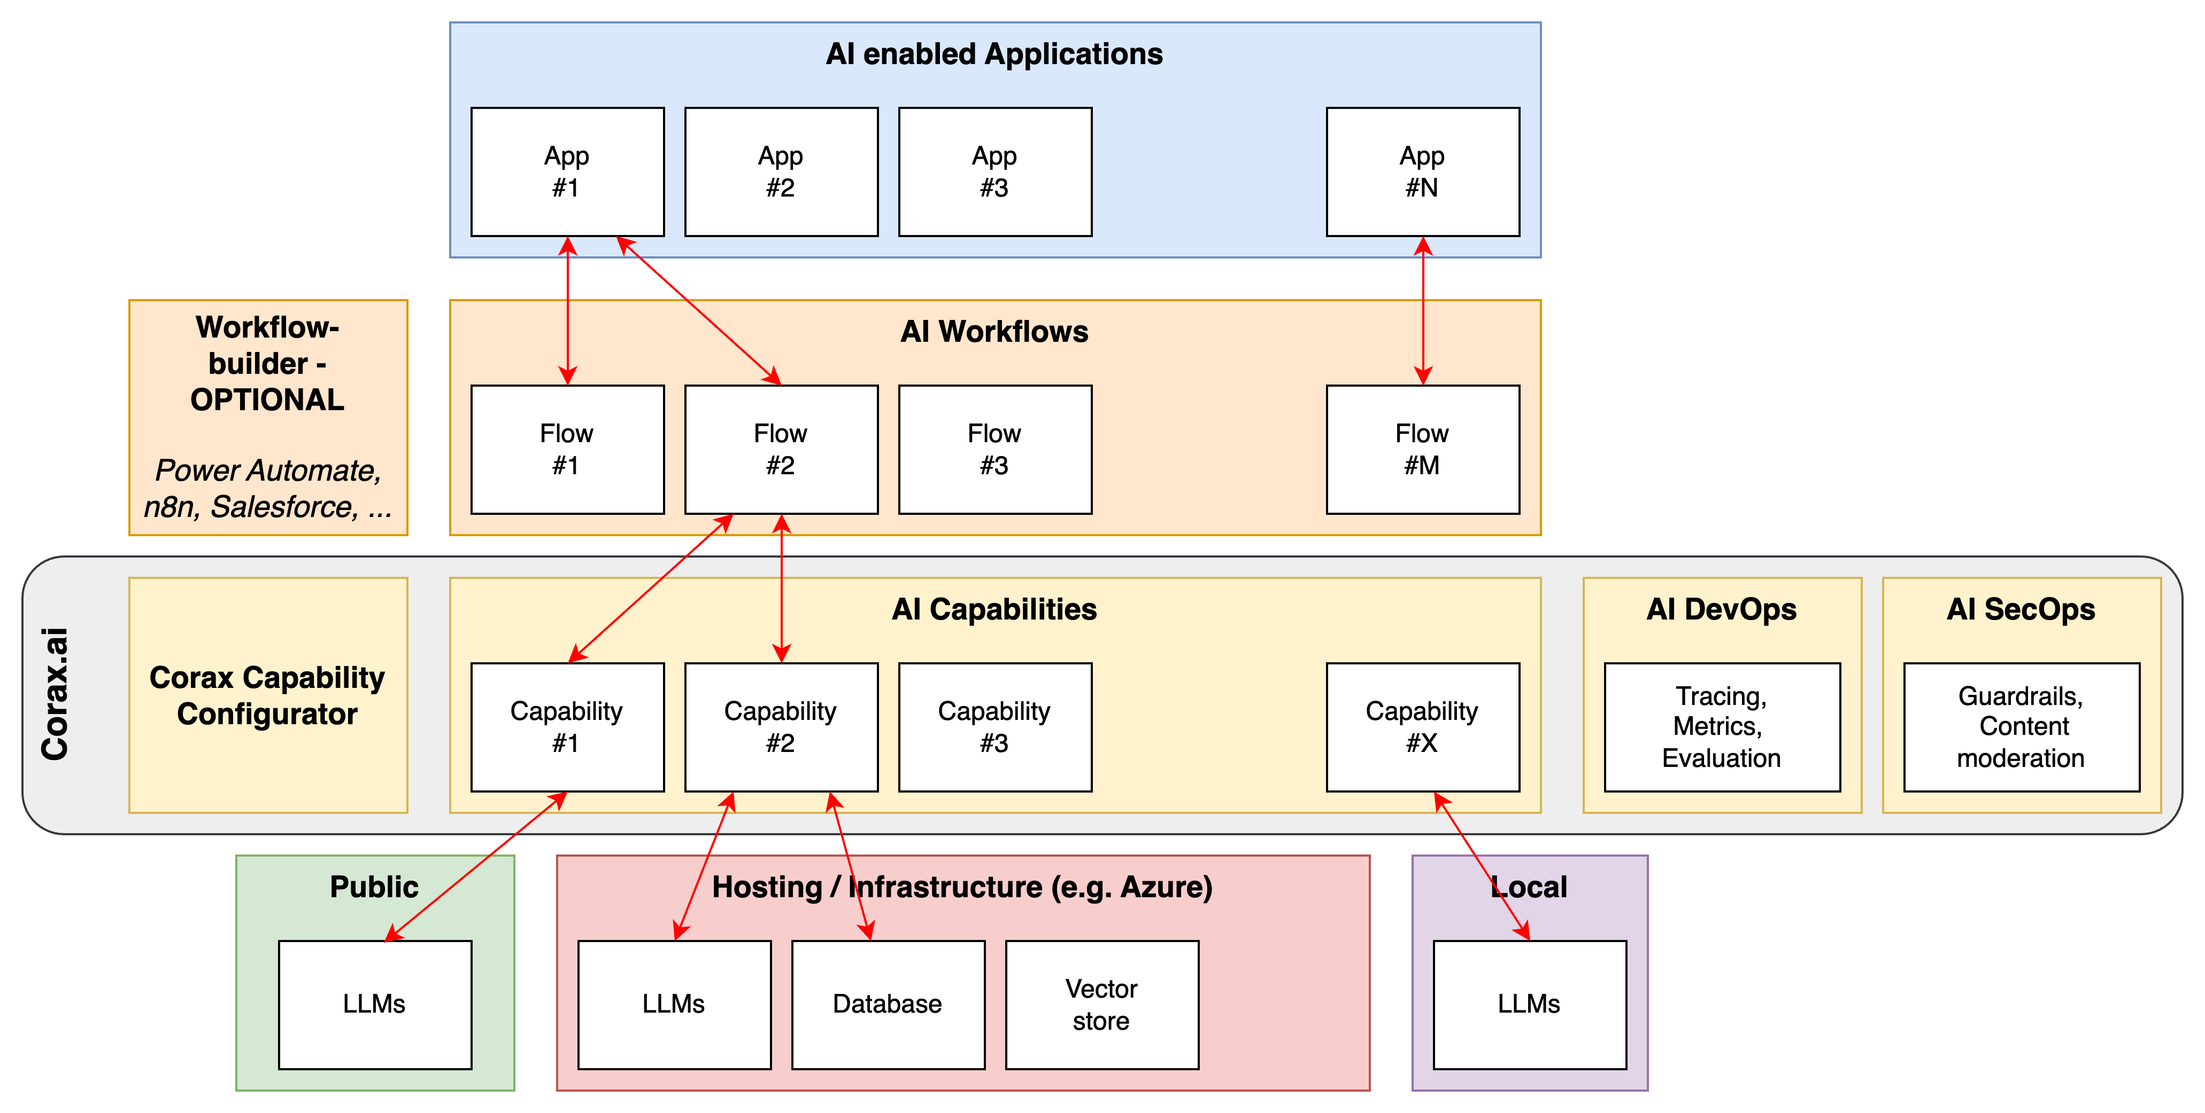
Corax
CORAX AI
Corax AI is a collection of tools that makes it easy and safe for clients to configure, deploy and monitor AI capabilities.
Corax AI is a non-intrusive, but important layer between your AI platform and your workflow/application layer.
Notes:
Fremhæv workflow og mulighed for at anvende forskellige LLMs (Local / Cloud)
Slide 9 and 10 says the same. Use this one if audience is a little technical
Emphasize the point with Local hosted AI (purple box) for critical data or in light of current geo political situation

Slide 14
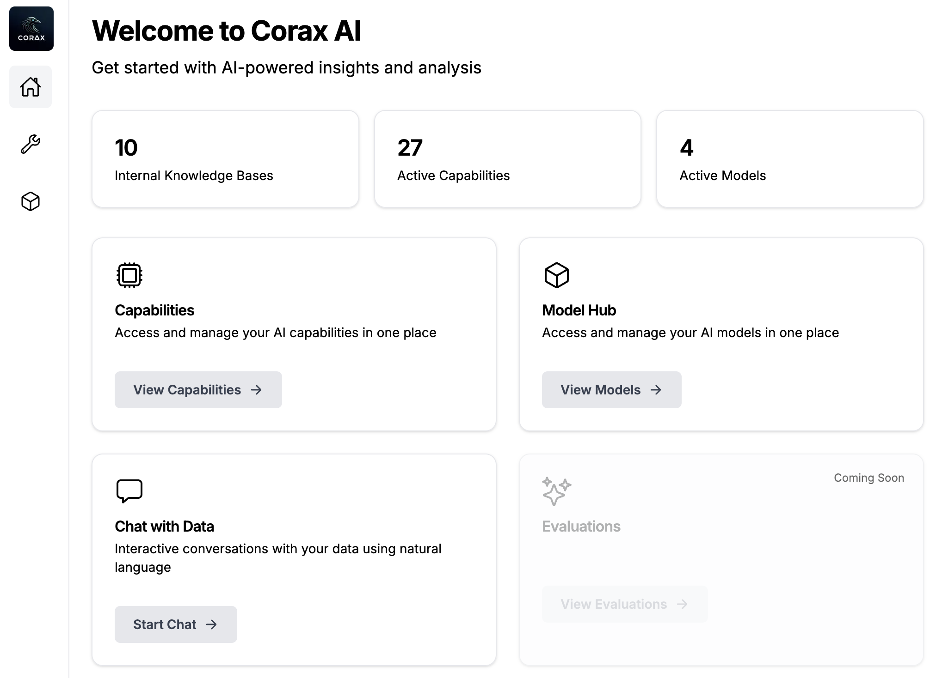

Slide 15







Workflows already supported
CORAX AI
Project/Account/Customer Summaries
Your
use cases
Meeting Summaries
Document evaluation
Credit scoring
Applications (job/funds/loan)
Supplier contracts
Sentiment Analysis
App Store/Customer support/Trust Pilot
Answering customer emails and ratings
Chat-Bots/ Talk to Your Data
Notes:
Frigør tid
Un-biased
Bedre Compliance
Skarpere datagrundlag til optimering og insigt

Slide 16


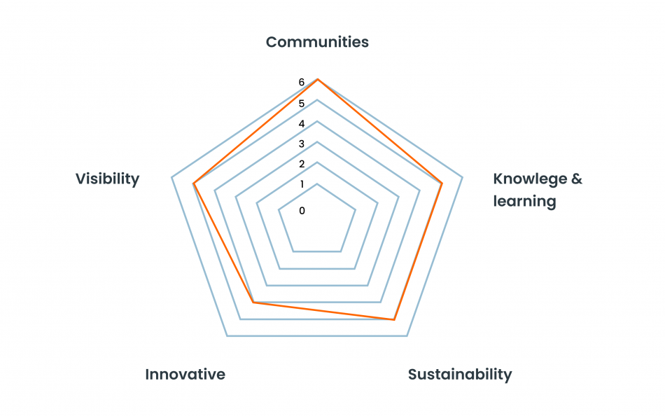
Streamlining grant application evaluation with AI
Scaling Impact with AI
Spar Nord Fonden faced challenges in evaluating over 3,000 annual grant applications. With limited resources, the foundation needed an efficient, scalable solution to streamline the evaluation process without compromising quality.
The Solution
Trifork developed an AI-powered system to automate the evaluation of grant applications. By integrating the foundation's six core impact principles, AI quickly analyzed, summarized, and scored applications, reducing evaluation time by 25%. The modular, secure solution was built on Next.js and Python, using Azure for compliance and scalability.
The Result
The system, deployed in just 175 hours, saved significant time and allowed Spar Nord Fonden to focus on its mission. Continuous feedback refined the platform, which now supports ongoing AI enhancements. This collaboration demonstrates the value of agile development and AI in driving impactful outcomes.

Slide 17
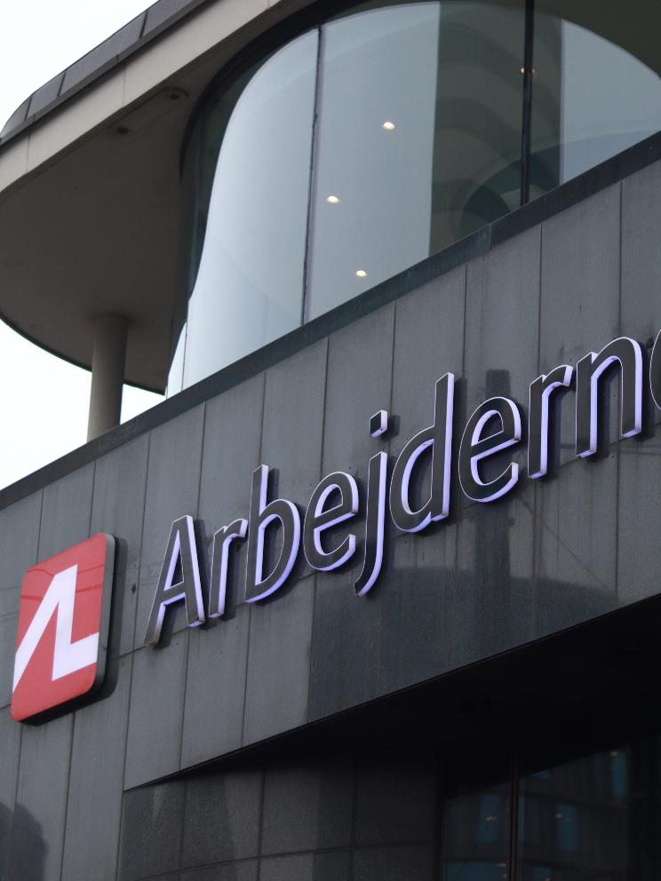
Introducing ALai: Arbejdernes Landsbank new chatbot
Smarter Workflows, Happier Employees
Arbejdernes Landsbank wanted to improve internal workflows by making it easier for employees to access routine information—starting with HR. In collaboration with Trifork, they developed ALai, a secure AI chatbot designed to give fast, accurate answers and reduce time spent on repetitive queries.
From Idea to Live in 2 Days
Built using Trifork’s Corax AI Enablement platform, the first version of ALai was launched in just two days. The chatbot integrates seamlessly into the bank’s systems and uses advanced search techniques to deliver relevant responses from internal knowledge bases.
Used Daily by 170 Employees
Today, 15% of the workforce uses ALai daily. It’s become a valuable tool for saving time, improving employee support, and enabling focus on more complex tasks. With a scalable setup, ALai is ready to grow across departments and business areas.
Notes:
3k sager årligt, stigende
Reducerede evalueringstid med 25%
Bruger ca. 90% af det output, AI kommer med
Alt på kun 175 timer.

Slide 18
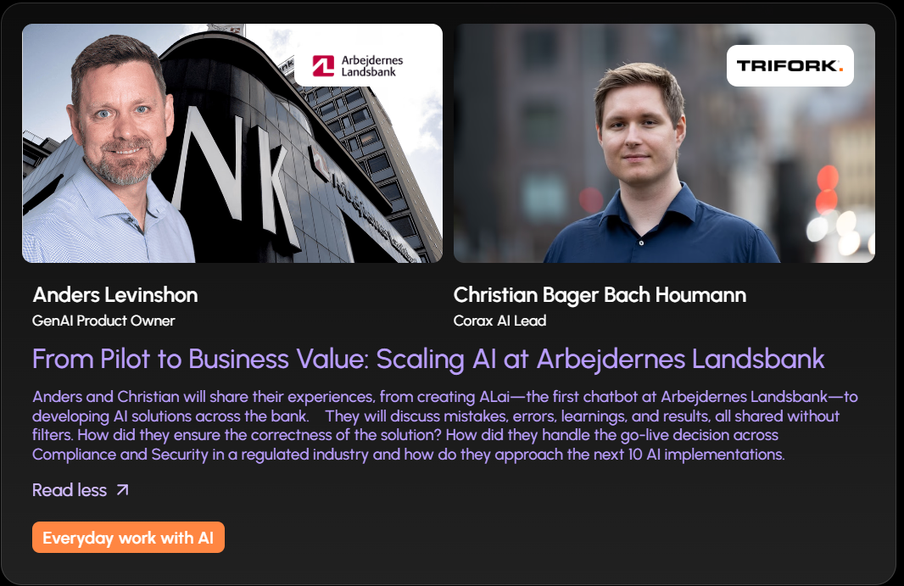
Pilot->Production-> “AI Factory” in 4 months
JOIN US AT: APPLIED AI NORDICS 3RD APRIL COPENHAGEN
Notes:
The secret here is 3 parts:
A skilled Product Owner (Anders)
A skilled AI + Full stack developer. AI alone doesn’t do the thing (Christian)
A tool (Corax)
The first solution was not build on Corax, but it became obvious for AL that in order to speed up development, control versions and adaptation and reuse AI capabilities across solutions a tool like Corax is required

Slide 19


AI-Mail Assist facilitates workflows and handles large customer growth at OK
More products = increased complexity
OK experienced rapid growth in both customer base and product offerings. As customer inquiries skyrocketed, OK’s customer service team faced increased pressure to respond quickly and accurately, while maintaining high service levels.
AI-Powered Response Automation
In close collaboration with OK, Trifork implemented AI-Mail Assist, an intelligent assistant that helps match incoming email inquiries with relevant knowledge and generates response drafts automatically. This AI solution enables customer service representatives to focus on complex and value-creating inquiries, while repetitive questions are handled more efficiently.
50% Less Manual Work
AI-Mail Assist now handles a large share of customer inquiries—over 50% of email responses can be sent with little or no manual customization. The result is faster response times, higher employee satisfaction, and more time for advisory and sales efforts. Trifork continues to support OK in shaping business knowledge for future AI enhancements.
Notes:
3k sager årligt, stigende
Reducerede evalueringstid med 25%
Bruger ca. 90% af det output, AI kommer med
Alt på kun 175 timer.

Slide 20










Features in Corax AI
CORAX AI
BUILD YOUR AI capabilities
Build your AI capabilities
Create, configure and maintain AI capabilities for specific purposes.
Build a custom knowledge library
Create knowledge collections with company guidelines, documentation, and other essential information for AI-assisted tasks.
Multimodal
Supports various file formats, including images, PDFs, and structured data outputs. More formats, such as audio, are already planned.
Evaluate your AI
Provides tools to assess and refine AI performance to prevent errors and improve accuracy.
Gain insights into which capabilities are most utilized
Provides insights into each capability’s input and output through Langfuse.
INTEGRATION & SECURITY
API first ensuring seamless integration
Serves as a layer between AI systems and existing workflows, enabling easy configuration, deployment, and monitoring.
Scalability & Security (AD integration, active directory, ENTRA)
Designed to be scalable, secure, and cost-effective, facilitating the transition of AI from data science to real-world applications.
ML Ops & Dashboards
Integrates with DevOps tools for monitoring calls, latency, costs, and load balancing. Includes security features to protect against prompt injection, detect data leakage, and moderate content.
Model Deployment so you can use any AI model
Work with any AI model, whether cloud-based or on-premise, giving full flexibility over AI infrastructure.
Collaborate with others
Export and import capabilities so collaboration across your
organization is easier.
Notes:
Hvis vi skulle præsentere i dag, hvordan vil det se ud.
Collaboration punkt (export)
Use icons from menu (capabilites, knowledge collections)

Slide 21

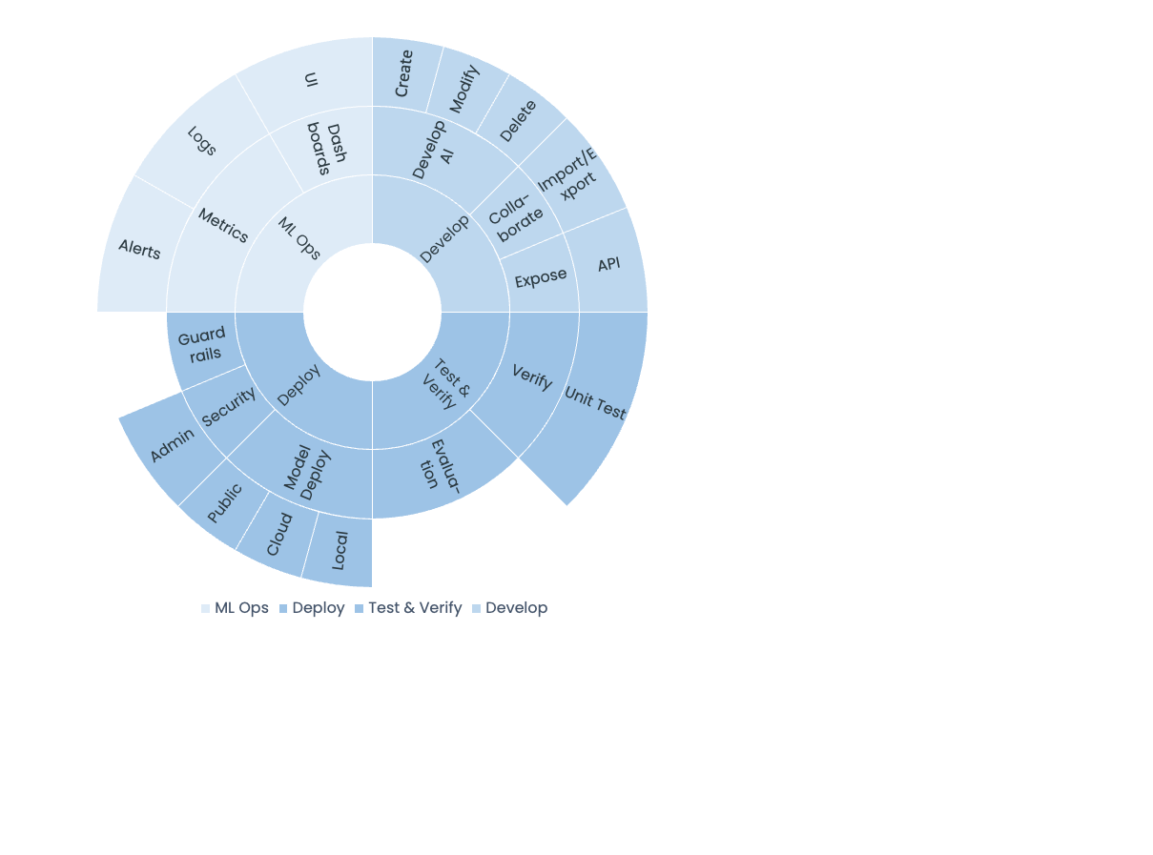

Slide 22
Corax Product Suite
Corax AI – AI Enablement Platform
Development and deployment of GenAI solutions
Corax Data – Data and Integration Platform
Empower organizations to make data-driven decisions across all applications
Corax Vision – Vision AI platform
Vision AI platform for solutions like quality control, passenger counts, production and more
Corax
AI
Corax
Data
Corax
Vision

Slide 23
Corax & Workflow demo
Notes:
Use videos from brand.Trifork.com or live demo

Slide 24
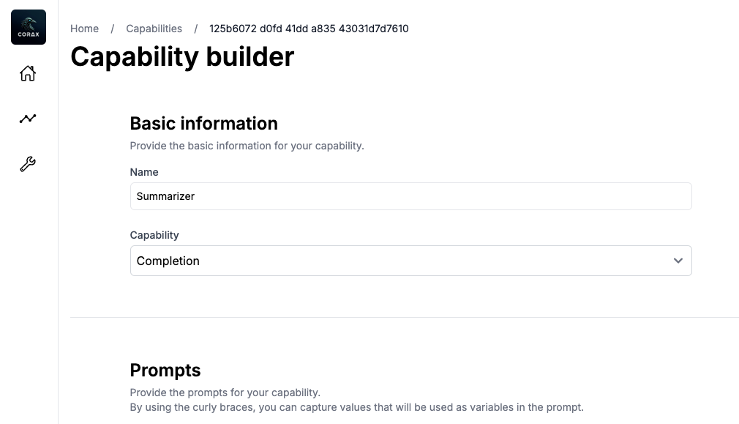
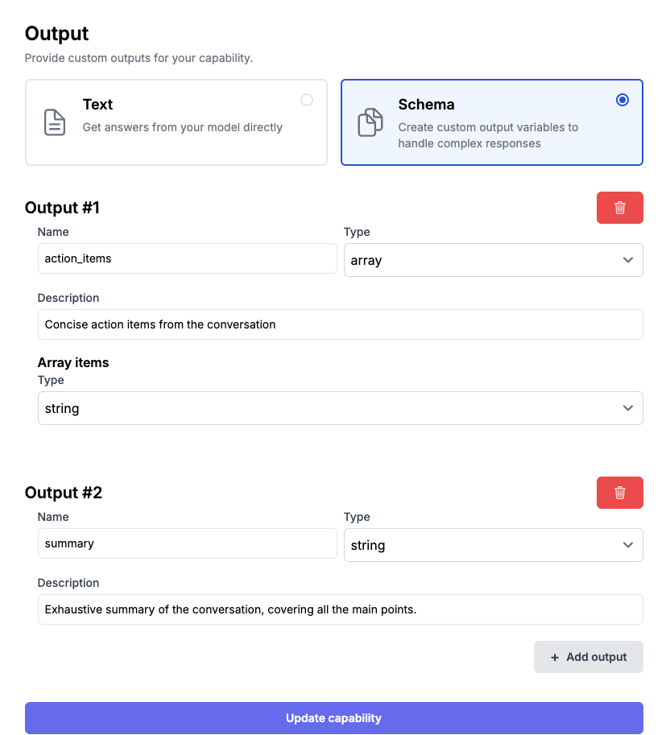
MEETING SUMMARY
Demo:
Building a meeting summary workflow
Make a meeting summary for an online customer meeting
Configure 4 AI capabilities in the Corax AI user-friendly UI
Deploy → Done
Notes:
Note: This typically takes a few hours to iteratively get the prompts correct.
Video: Corax ai – workflow summary

Slide 25
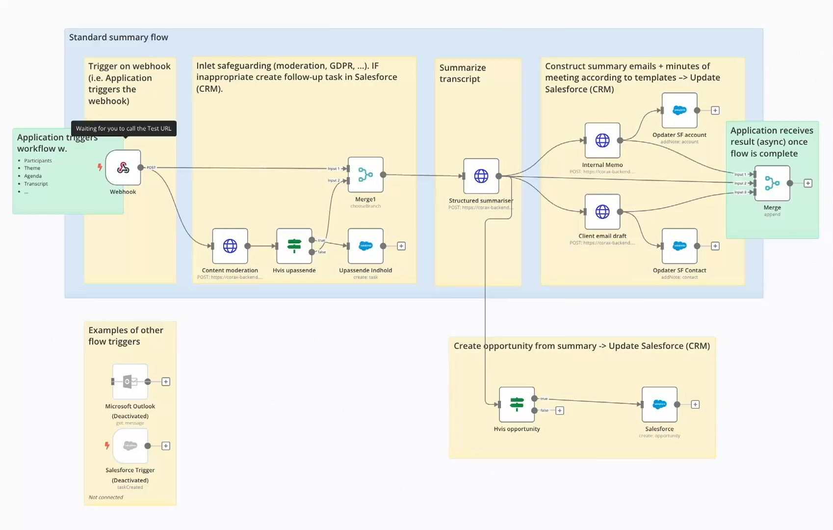
BUILDING A MEETING SUMMARY
Made by Corax it is easy
Notes:
Note: This typically takes a few hours to iteratively get the prompts correct.

Slide 26



Features - Roadmap
CORAX AI
Core Features
Capabilities
SecOps
DevOps
API first
Completion
Prompt injection protection
AD integration
Capability
configuration
Chat
Tracing
Data leakage detection
Capability versioning
Knowledgebases
Content moderation
Calls
Prompt library
RAG
Generation
Capability library
Realtime *STS/STT/TTS
Latencies
Extension through
plug-ins
Agents (tools)
Cost
Multi-modality
Users
Model agnostic
Load-balancing
Bring your own model
User feedback
LLM Eval framework
*STS/STT/TTS: Speech-to-Speech, Speech-to-Text, Text-to-Speech

Slide 27
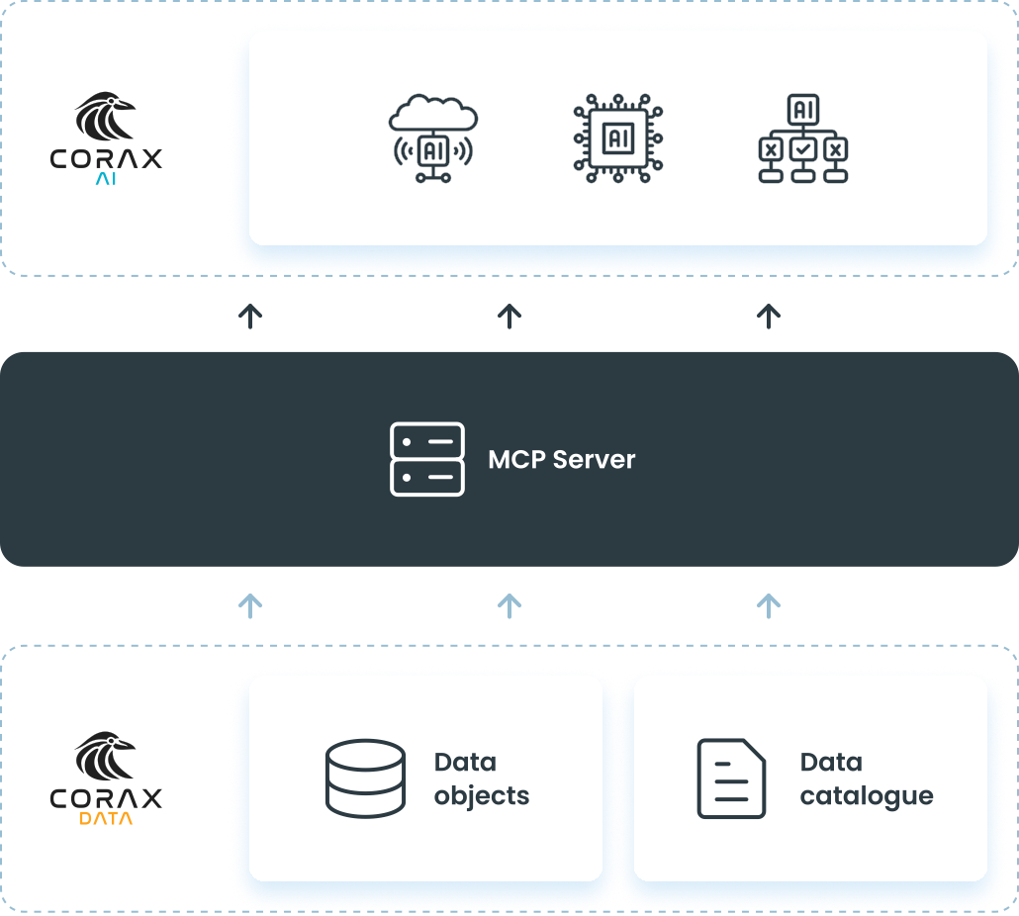

Slide 28


